Slide 1
REDCap Training 101
Introduction to building project in REDCap
Sui Tsang
REDCap@Yale Team
1/24/2022

Slide 2
Introduction and Learning Objective
Learn how to access training materials.
Understand how to set up a REDCap project.
Know how to manage user rights.
Find out how to export data to statistical packages.

Slide 3
What is REDCap?
Web-based software used to create and manage research databases and participant surveys.
Developed as a tool to help researchers collect and manage data effectively and responsibly.
Notes:
What is REDCap? REDCap is a web-based software used to create and manage research data. It is developed as a tool to help researchers collect and manage data effectively and responsibly.

Slide 4
What are the advantages of REDCap?
Accessible
remote web-based access (on and off campus)
Customizable
fast and flexible to design
modifications at anytime
Accurate
ensures consistent and accurate data entry
data quality checks to look for errors
access for multi-site collaborations
Secure
multi-factor user authentication using Yale Active Directory
data stored on secure cloud servers protected by firewalls
Notes:
What are the advantages? REDCap can be accessed anywhere in the world with internet access. It is perfect for multi-site collaborations. Designing project in REDCap is easy and fast and you can make modifications anytime. There are many features built in REDCap to ensure data consistency and accuracy. It is also secure. We use Yale active directory for authentication with DUO MFA. The data are stored on ITS maintained secure servers.

Slide 5
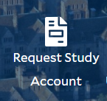


How do I get set up in REDCap?
To request a new account, select Request Study Account on the REDCap@ Yale portal website.
Two REDCap implementations available:

Slide 6
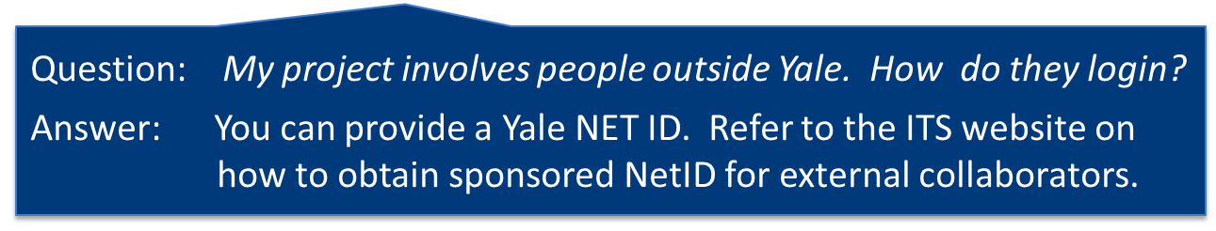
REDCap@Yale
Yale NetID and password is required for login
  CANNOT reset password in REDCap. Reset your Yale NETID through Yale ITS.
Notes:
Yale Netid is required for login. If you would like to give external collaborators access to your project, you can obtain sponsored netid for them. ITS’s website has all the information you need on how to request for sponsored netid.

Slide 7
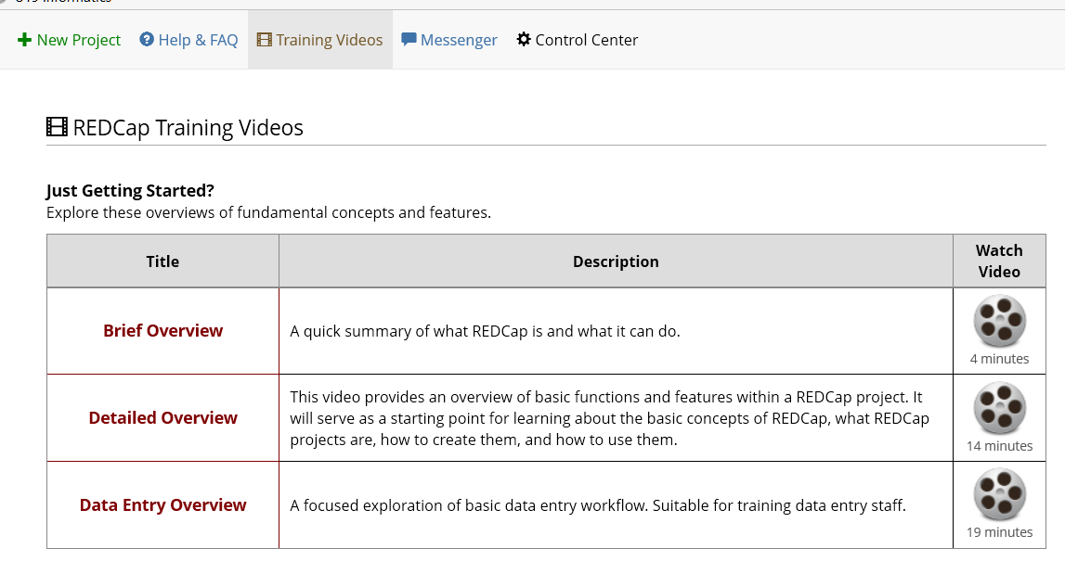
Training Resources
23 training videos available in REDCap
Notes:
There are many training videos in the REDCap applications. It is designed so that anyone can learn how to use REDCap at their own pace.

Slide 8
List of Training Videos
Brief Overview
Detailed Overview
Data Entry Overview
Introduction to Instrument Development
Online Designer
Data Dictionary
Project Field Types
Applications Overview
The Calendar
Scheduling Module
Data Access Groups for multi-site projects
Types of Projects
Traditional Project
Single Survey Project
Longitudinal Project
Longitudinal Project + Scheduling
Operations
Defining Events in Longitudinal Projects
Designating Instruments for Events in Longitudinal Projects
Repeatable instruments and events
REDCap Mobile App
Locking Records
Data Resolution Workflow
Notes:
There are currently 23 videos available. The videos cover everything you need to set up a REDCap project. The materials that we go over today are indicated in red here. If you have questions later, you can go back to watch these videos.

Slide 9
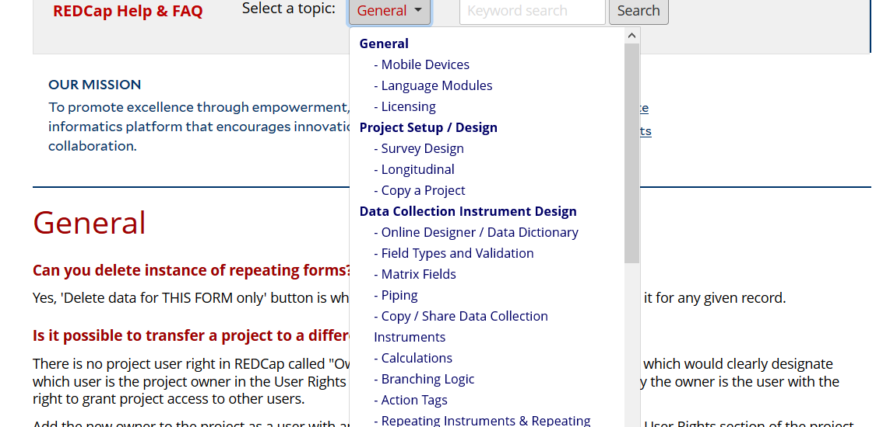
Training Resources
Where can you find help and answers?
HELP & FAQ in REDCap
  This is also a good place to look up syntax for calculated field, branching logics or piping.
Notes:
The help and FAQ in REDCap also has very useful information. You can find answers to most REDCap questions in the FAQ. It is also a good place to look up syntax for branching logics, calculated field or piping.

Slide 10
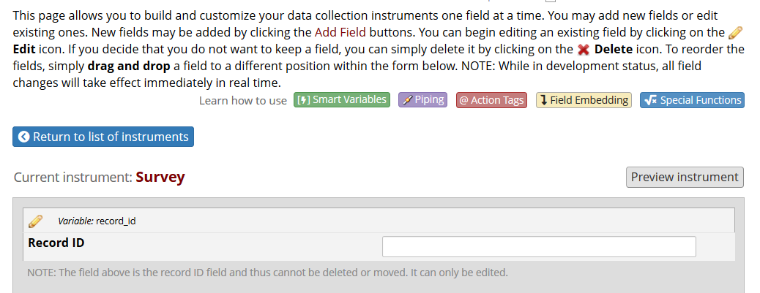
Training Resources
‘How to’ links throughout REDCap. For example, in online designer:
Notes:
There are ‘how to’ links throughout REDCap. For example, in the online designer, you will see links on how to set up fields, action tags, smart variables and piping.

Slide 11
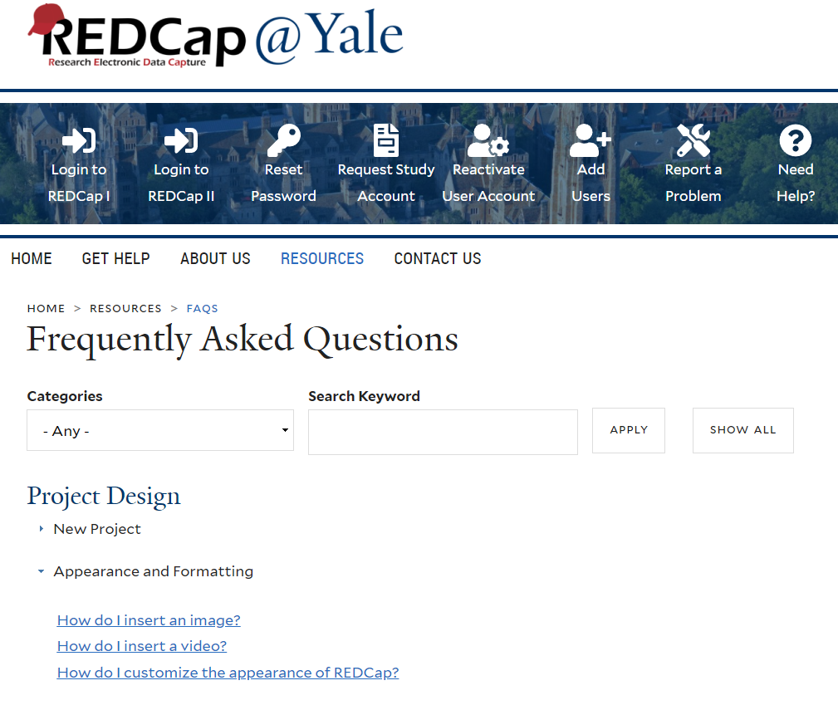
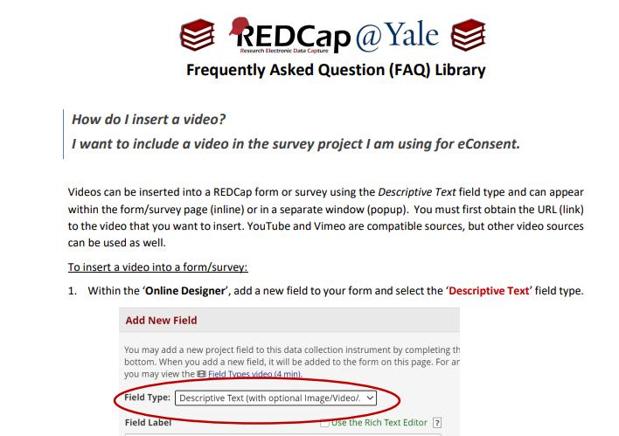
MORE Training Resources
Where can you find help and answers?
HELP & FAQ on the REDCap@Yale portal website
  We also offer a library of step-by-step tutorials to address commonly asked questions from our Yale end-users.

Slide 12
QUESTIONS?

Slide 13
SETTING UP YOUR PROJECT:
WHERE DO I BEGIN?

Slide 14

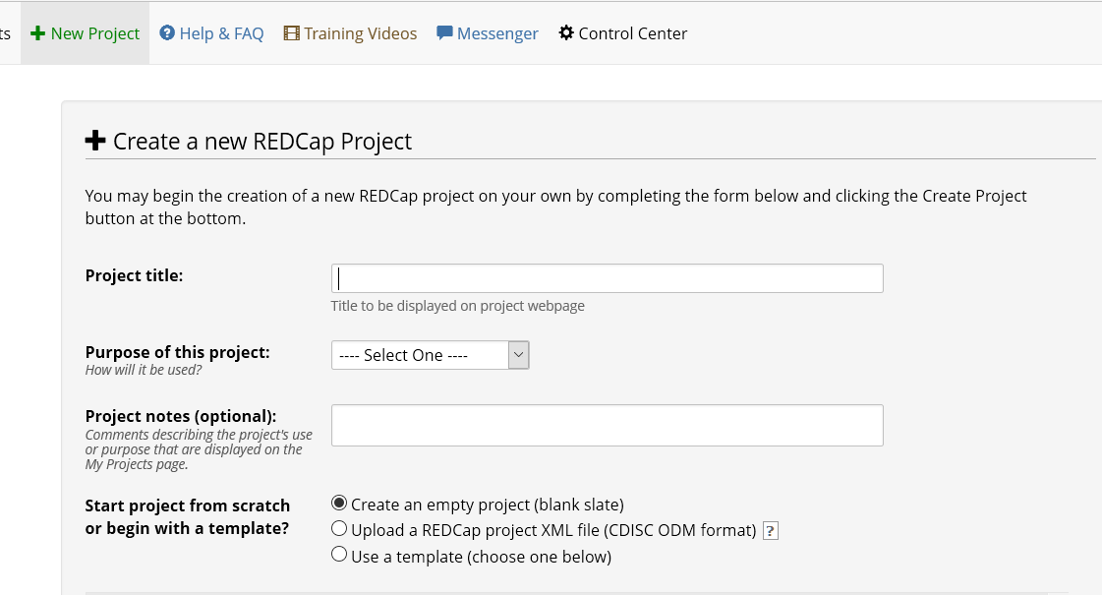
How do I create a new project in REDCap?
REDCap FAQ
Project Design
Click the ‘+New Project’ tab, fill in the form
  Remember to enter the PI and study information
Click ‘Send Request’.
After we verify you have an account, we will create the project and notify you via email within 1-2 business days.
Notes:
After you set up your study account, you can start to create project. You can click the ‘add new project’ tab in REDCap to request for a new project. Make sure you enter the PI and the study information as we will need the information to verify if the project is linked to a study account. If everything looks fine, we will create the project and notify you through email.

Slide 15
Decide What Type of Project is Needed
Classic Database – Each form can only be completed once. One record per subject.
Longitudinal –
    Data collected multiple times per subject
      Fixed number of collection points that correspond to pre-defined events (e.g. initial evaluation, 3mo. follow-up, 6mo. follow-up, 1yr follow-up)
    Optional scheduling via a project calendar
    Can have multiple study arms

Slide 16
Decide How to Collect the Data
Data Entry
  Data entered by REDCap users (i.e. research staff).
  Offline data collection available via mobile app.
Survey
  On-line survey completed by participants.
  Participants do not need to have a Yale NetID.
A project can have both
surveys and data entry forms.

Slide 17
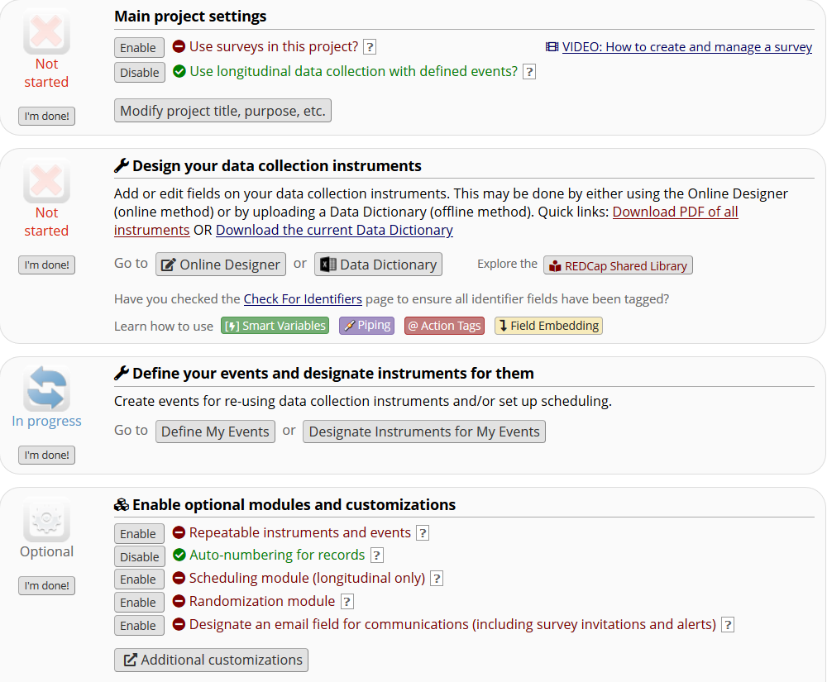
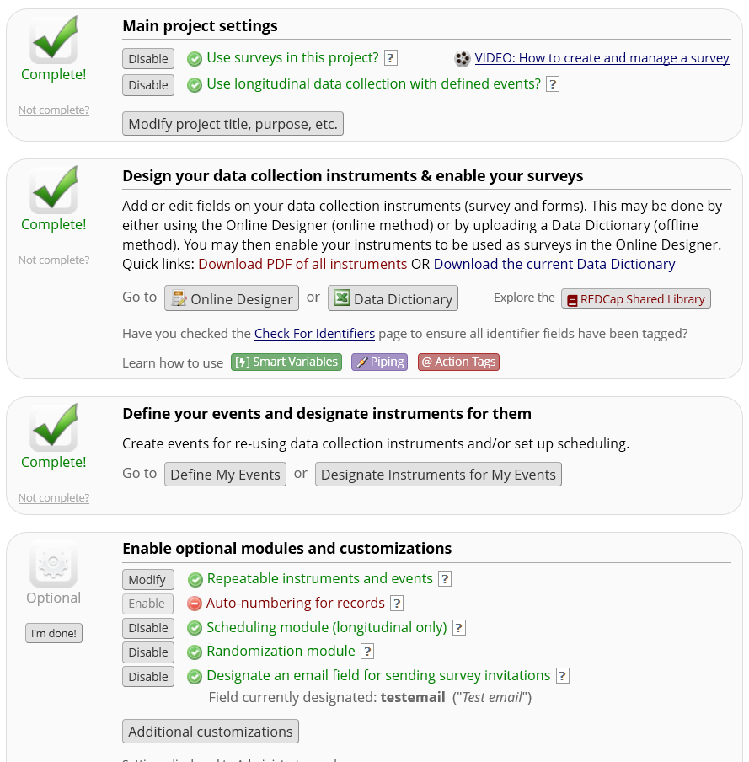
How to Set Up your Project
Notes:
To set up your project, follow each step in the project set up page. The following slides will explain each step.

Slide 18
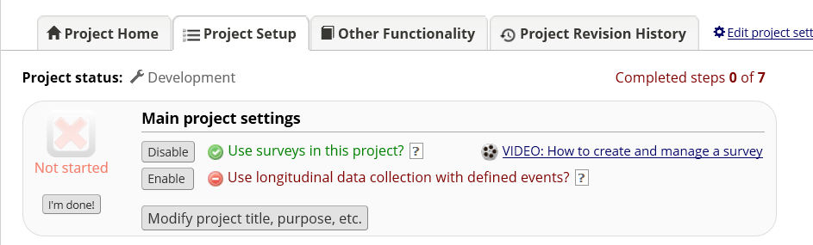
Project Setup: Enable Settings
If applicable:
Enable longitudinal setting
Enable survey setting
Notes:
The default setup is classic database. If you have multiple time points in your projects or utilize surveys, make sure you enable the corresponding option in project setting.

Slide 19
How to Set Up your Project
Notes:
After you set up the main setting, you can start to build your instruments.

Slide 20
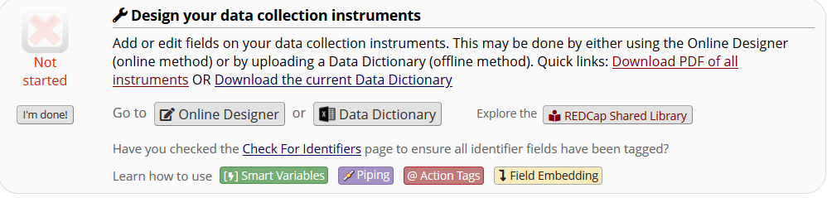
Project Setup: Build your Design Instruments
Design the project instruments using either (a.) online designer or (b.) data dictionary.
Notes:
There are two ways to design instruments, on-line designer and data dictionary. On-line designer is very easy to use and is interactive, perfect for new users. Data dictionary is a more advanced method and is good for experienced users.

Slide 21
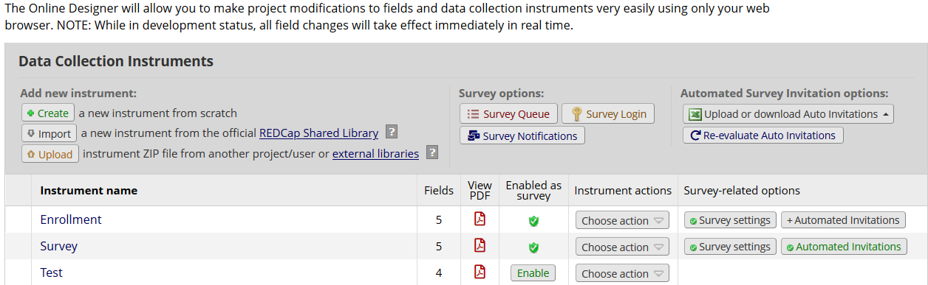
Project Set Up: Building with the On-line Designer
On-line Designer
  Allows you to create/modify/delete data collection instruments and fields (questions) using your web browser.
  Changes are made in real time and available immediately for review and testing.
Notes:
You can create a new instrument from scratch in on-line designer or import an instrument from REDCap shared library. You can also upload an instrument zip file from external libraries or other projects.

Slide 22
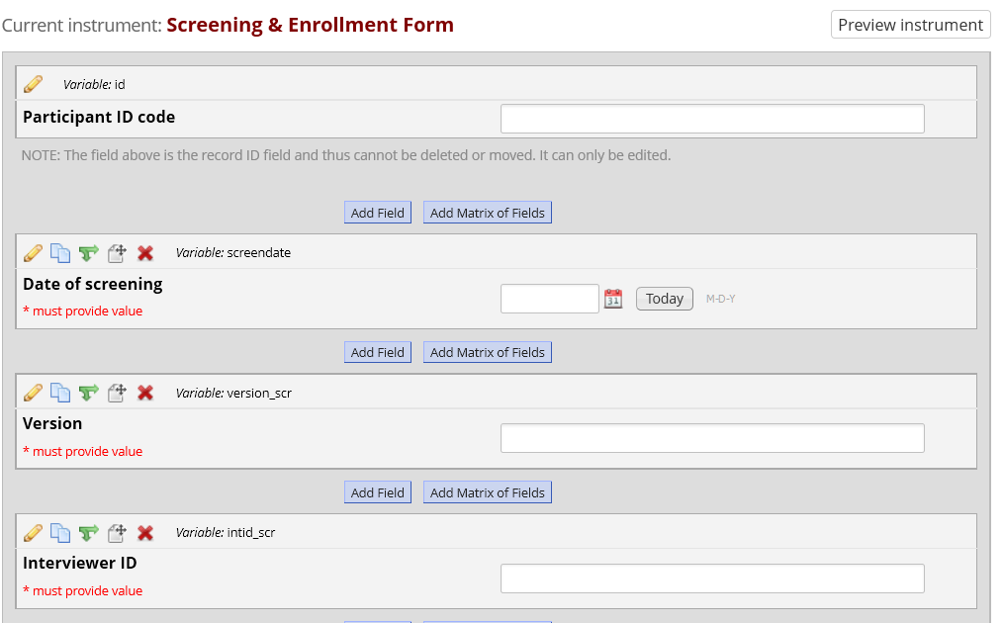
Project Set Up: Building with the On-line Designer
3. Specify branching logic
4. Move field (can move to other form)
2. Copy field
1. Edit field
5. Delete field
Notes:
After you added a form to online designer, you can open the form to add fields. There are 5 buttons on the top of each field. The pencil button allows you to edit field, the second button allows you to copy field, the third one is for setting up branching logics, the fourth button is for moving field. Field can be moved within the same form or to another form. The last button is for deleting field.

Slide 23
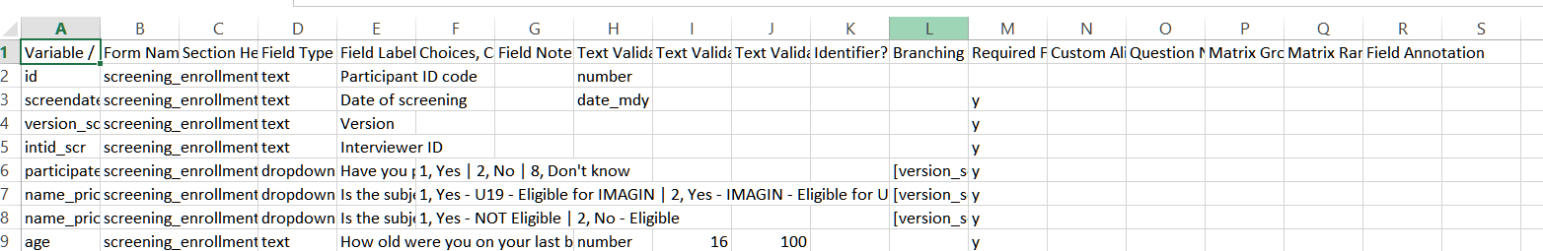
Project Set Up: Building with the Data Dictionary
b. Data Dictionary
  The Data Dictionary is a formatted spreadsheet in CSV (comma separated format) containing the metadata used to construct data collection instruments and fields.
This is recommended for advanced users.

Slide 24
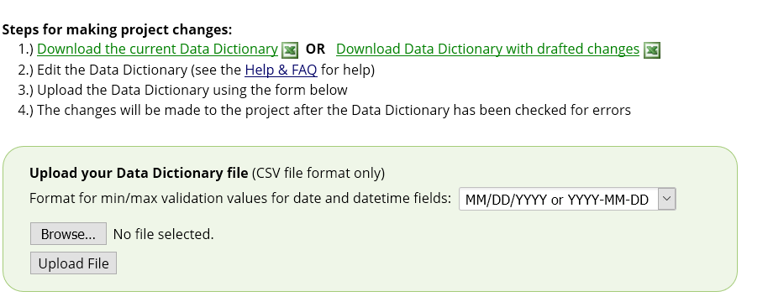
Project Set Up: Building with the Data Dictionary
To use this feature, you will download the current dictionary, make modifications, and THEN upload the modified data dictionary on the data dictionary page.
IMPORTANT: Always upload the ENTIRE data dictionary. Never upload a partial data dictionary.

Slide 25
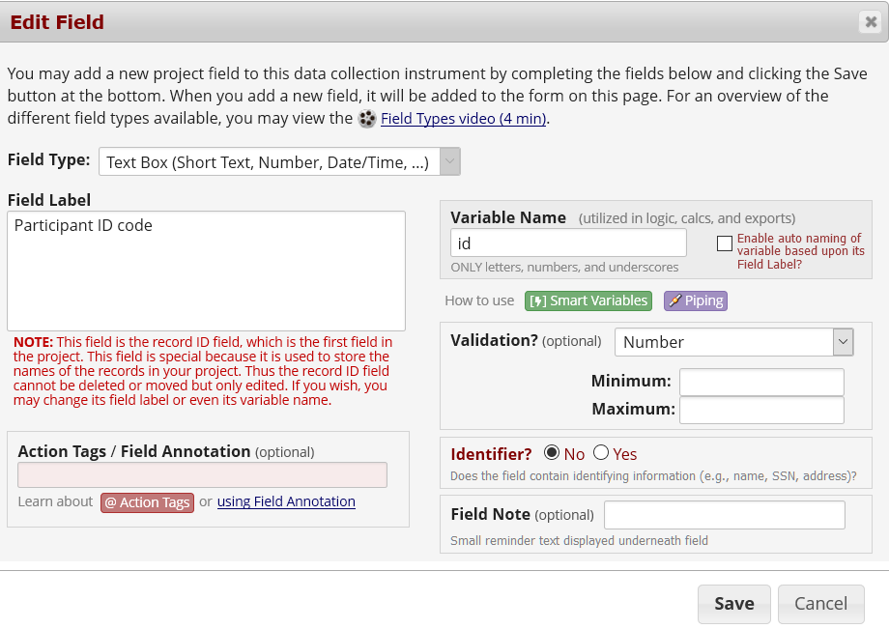
Building Forms: Using the Online Designer
First field of the first form must be the record key (e.g. Participant ID).
  This field cannot be deleted or moved.
  Data in this field must be unique.
  This field can be auto-assigned by REDCap
(Project Setup → Enable optional modules→ Enable auto-numbering for records)
Notes:
When you click the pencil button, the edit field page will open, you can enter the label and field name of your field and set up validation. The first field of the first form has to be the record key (e.g. participant ID). This field cannot be moved or deleted. You can set it up as auto-assigned by REDCap.

Slide 26
Building Forms: Field Name
Each field name must be:
  Unique
  Lowercase
  Contain fewer than 26 characters
  Contain only letters, numbers, and underscores.
In general, field names should be as short in length as possible and maintain meaning.
Notes:
How to name your fields? Each field name must be unique. In REDCap, the field name must be all lowercase and may contain only letters, numbers and underscores. So no special characters for field names. Try to keep them as short as possible. It should be no more than 26 characters.

Slide 27
Building Forms: Field Types
TEXT | - single-line text box (for text, numbers and dates etc.)
NOTES | - large text box for multiple lines of text
DROPDOWN | - dropdown menu with options
RADIO | - radio buttons with options
CHECKBOX | - checkboxes to allow selection of more than one option
FILE | - upload a document
CALC | - perform real-time calculations
SQL | - select query statement to populate dropdown choices
DESCRIPTIVE | - text displayed with no data entry and optional image/file attachment
SLIDER | - visual analogue scale;
YESNO | - radio buttons with yes and no options; coded as 1, Yes | 0, No
TRUEFALSE | - radio buttons with true and false options; coded as 1, True | 0, False
MATRIX | - display a group of similar multiple-choice fields in a very compact area on a page
SIGNATURE | - draw signature with mouse or finger
Notes:
There are 14 field types in REDCap.

Slide 28
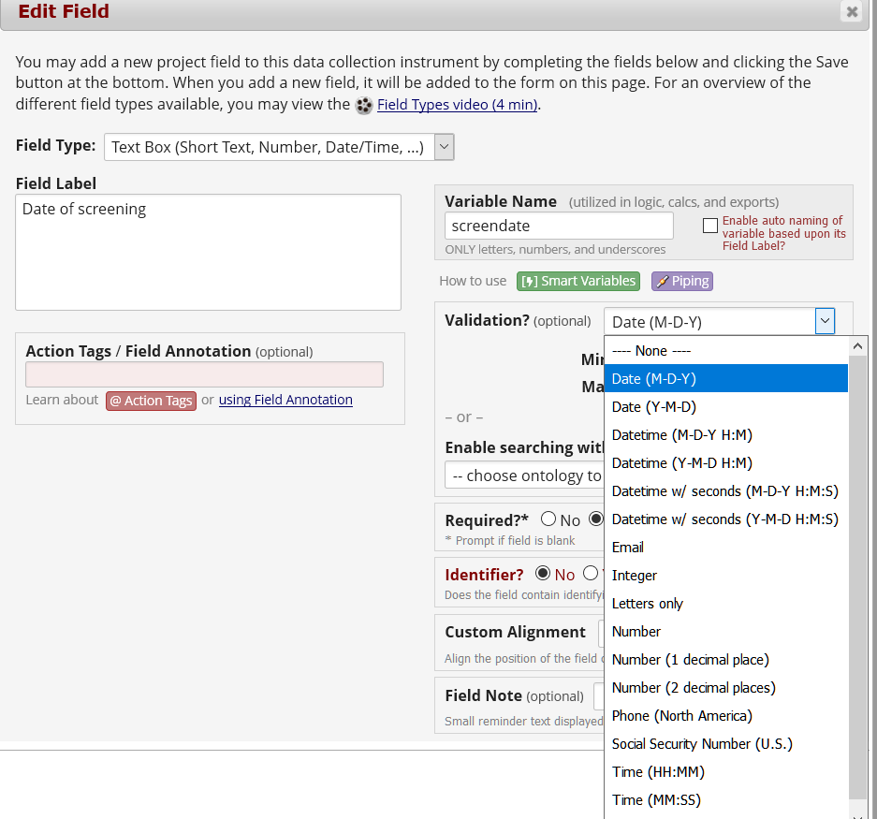
Building Forms: Using Validations
Validation is an important tool that can be used to prevent errors. It also helps when exporting data to statistical packages.
Notes:
Here is an example of text field with date validation.

Slide 29
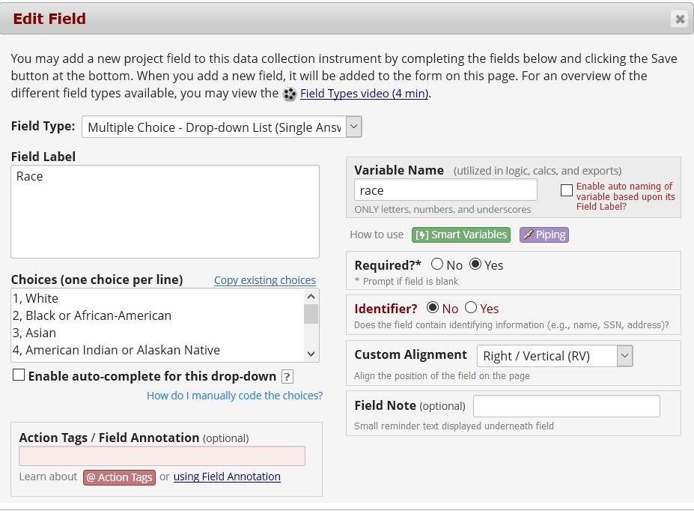
Building Forms: Drop Down Field
Notes:
Here is an example of drop-down multiple choice field. For multiple choice field, you will need to specify the choice code and label for the choices.

Slide 30
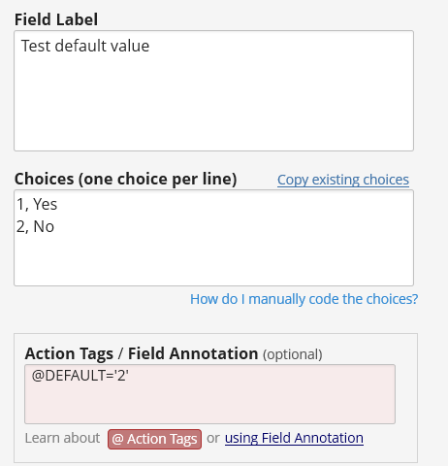
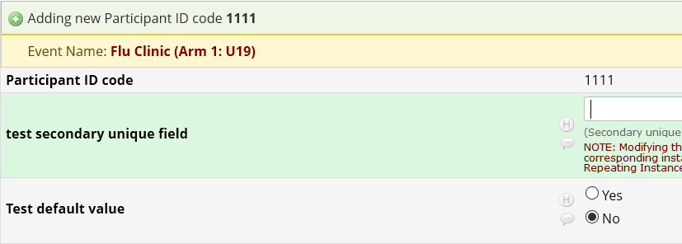
Building Forms: Action Tags
REDCap FAQ
Features-Basic
Action tags allow you to perform special actions within REDCap. Each action tag has a corresponding action that is performed for the field.
In REDCap, action tags begin with the '@' sign
  Placed inside a field’s “Field Annotation”.
Notes:
Action tags are special terms that begin with the ‘@’ sign. It is placed inside the field’s annotation box. Each action tag will perform a special action for the field. The example here uses the ‘@default’ action tag to set the default value of a field to 2. For the @default action tag, it will only work for empty form that has never been saved before. If your form already has data and you want to retrospectively set any missing data to a default value, the default action tag will not work. You will have to use some other ways to do it.

Slide 31
Building Forms: Action Tags
Currently available action tags
@APPUSERNAME-APP | @INLINE | @READONLY
@BARCODE-APP | @LATITUDE | @READONLY-APP
@CALCDATE | @LONGITUDE | @READONLY-FORM
@CALCTEXT | @MAXCHECKED | @READONLY-SURVEY
@CHARLIMIT | @MAXCHOICE | @SETVALUE
@DEFAULT | @NOMISSING | @SYNC-APP
@HIDDEN | @NONEOFTHEABOVE | @TODAY
@HIDDEN-APP | @NOW | @TODAY-SERVER
@HIDDEN-FORM | @NOW-SERVER | @TODAY-UTC
@HIDDEN-PDF | @NOW-UTC | @USERNAME
@HIDDEN-SURVEY | @PASSWORDMASK | @WORDLIMIT
@HIDEBUTTON | @PLACEHOLDER
@HIDECHOICE | @RANDOMORDER
Refer to REDCap on-line designer for description of each action tag
Notes:
Currently there are 37 action tags available. You can refer to REDCap on-line designer for description of each action tag.
Some of these action tags are new to REDCap. We have discussed these new action tags in last week’s REDCap New Features Training. If you missed the training, the slides are available on our website.

Slide 32
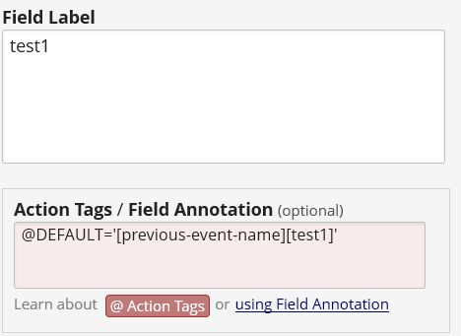
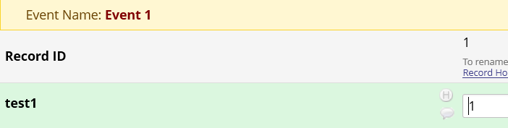
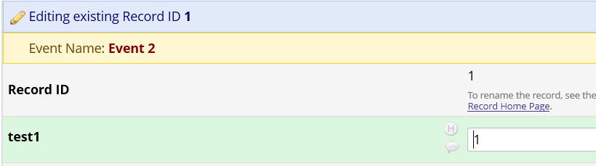
Building Forms: Smart Variables
Allow reference information other than data fields (e.g., event, repeat instance, DAG or users)
Example: Set the default value of a field to be the value of the previous event.
Notes:
In this example, the smart variable is used to carry over a value from previous event to the current event.

Slide 33
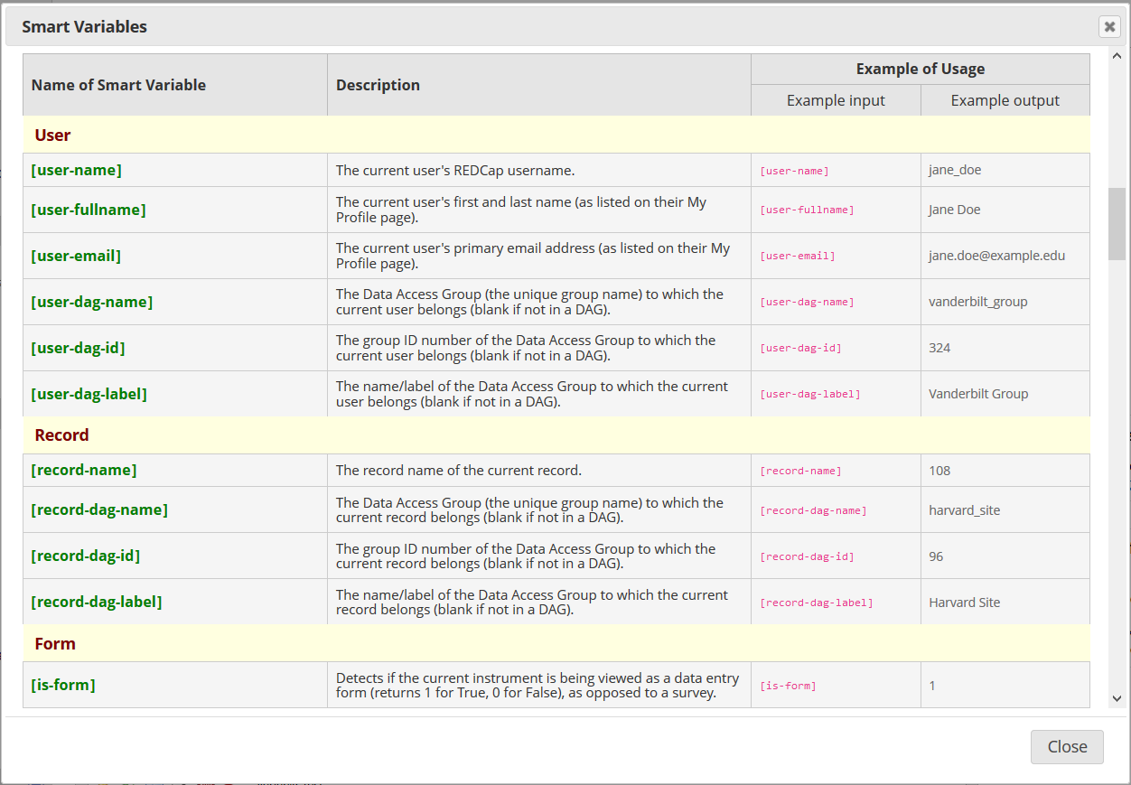
Building Forms: Smart Variables
Notes:
There are currently 69 smart variables available for reference to user, record, form, survey, event and arm as well as repeating instruments. Refer to REDCap for the descriptions of the smart variables.

Slide 34
Building Forms: Smart Variables Examples
Other examples:
Branching logics based on event name
[event-name]=‘baseline_arm_1’
2. Branching logics based on arm number
[arm-number]=‘1’
3. Age at first instance of repeating instrument
      [age][first-instance]

Slide 35
Building Forms: Tagging Identifiers
Fields that constitute protected health information (PHI) can be marked as an “Identifier”
These fields can then be excluded on data export, allowing for analysis of “de-identified” data
Users can also be restricted in their ability to export Identifier fields based on access rights

Slide 36
Building Forms: Calculated Fields
Calculations can only result in numbers (i.e., cannot use calculated field to concatenate strings or return a date).
Examples:
Age calculation: rounddown((datediff([dob],[hosp_date],"y")),0)
Sum of scores: sum([field1], [field2], [field3])
Refer to ‘Help and FAQ’ for more examples or click
in the online designer.
Best practice: Do not use calculated fields excessively on data collection instruments.
Notes:
Here a special note for using the sum function. The sum function will return a result even if some of your fields have missing data. If you use the syntax [field1]+[field2]+[field3], the calculation will not return a result if there is missing data. So you will need to see which syntax is more suitable for your data.

Slide 37
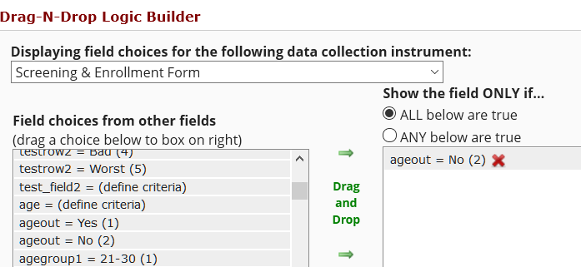
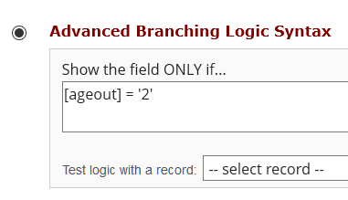
Building Forms: Branching Logic
You can use a Drag-N-Drop Logic Builder or Advanced Branching Logic Syntax
You can use fields on the current data entry form OR other forms
If fields from different events are used in branching logic, the field name needs to be preceded by an event name, e.g. [screening_arm_1][field1]
  Event names can be found in ‘Define My Events’ page

Slide 38
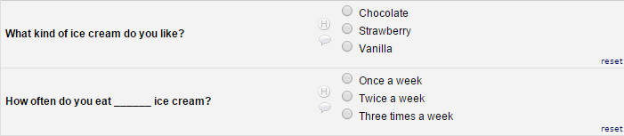
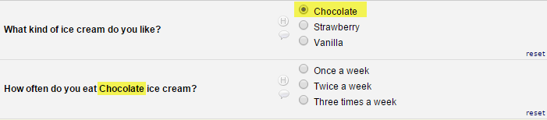
Building Forms: Piping
Without Piping:
With Piping:
Notes:
The 'Piping' feature in REDCap allows you to inject previously collected data into text on a data collection form or survey. This provides greater precision and control over question wording

Slide 39
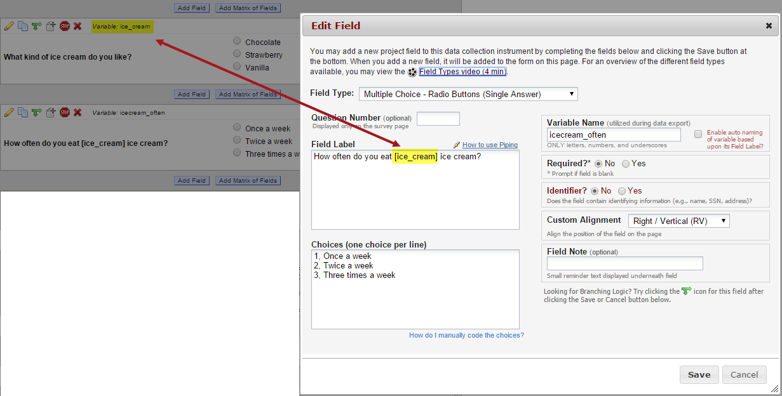
Building Forms: Piping
REDCap FAQ
Features-Basic
How to use piping:

Slide 40
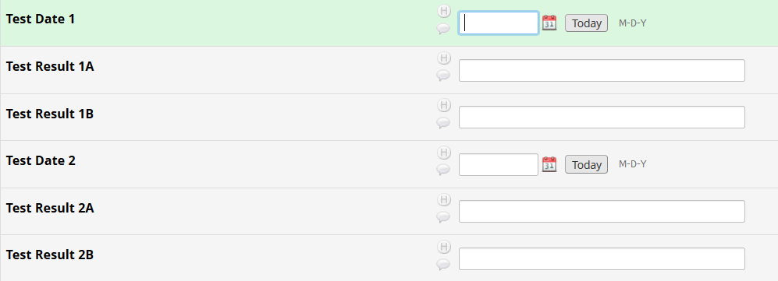
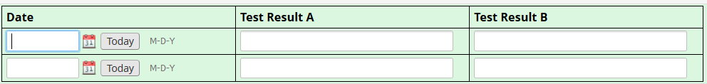
Building Forms: Field Embedding
No field embedding:
With field embedding:
Notes:
Ultimate way to customize your surveys and data collection instruments to make them look exactly how you want.
Allows you to reposition field elements on a survey page or data entry form so that they get embedded in a new location on that same page.
We have demonstrated how to use field embedding in the REDCap New Features training. If you missed the training, the slides are available on our website.

Slide 41
QUESTIONS?

Slide 42
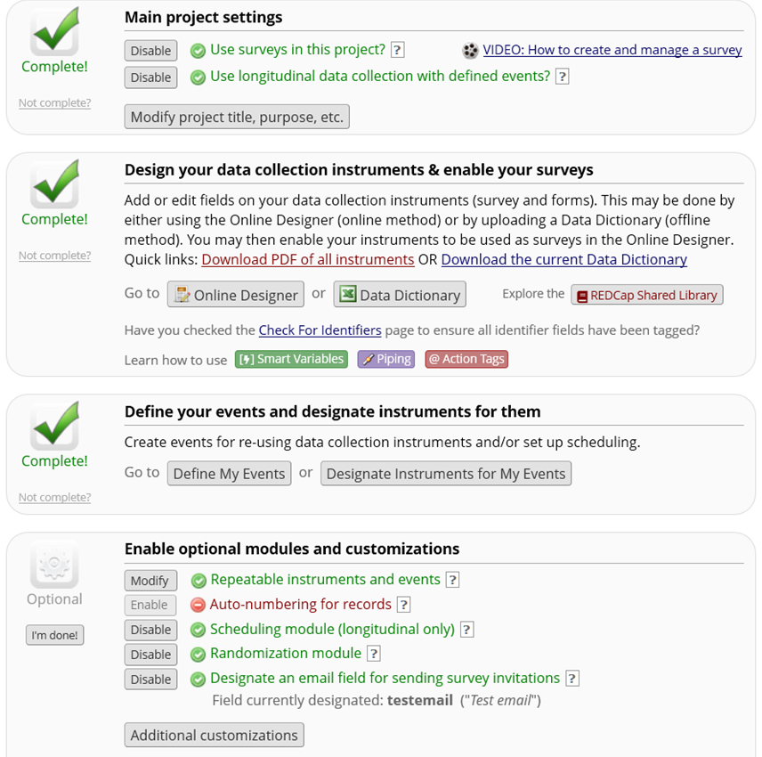
How to Set Up your Project
Notes:
Now we are done setting up the forms. If your project is longitudinal, the next step will be setting up the events.

Slide 43
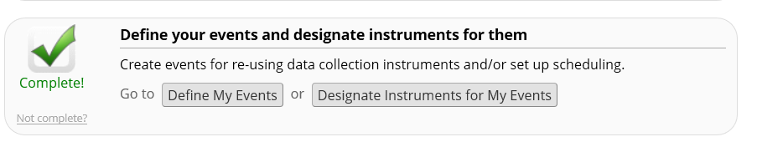
Defining Events
Longitudinal Projects
REDCap FAQ
Project Design
Defining Events allows you to:
  Use data collection forms multiple times for any given project record.
  Generate new schedules to display on the Calendar.

Slide 44
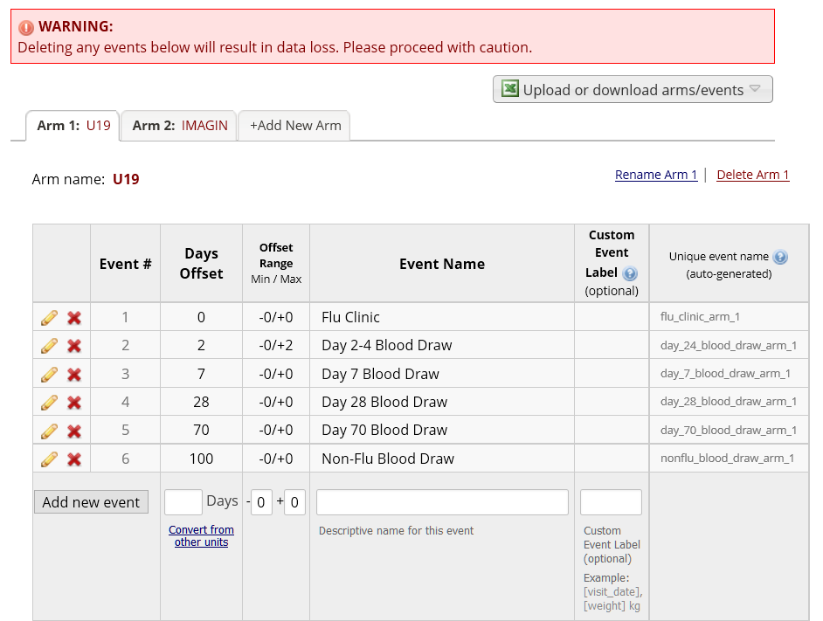
How to Define Events
Unique event name is auto-generated.
This is where you will find the event names for use in branching logic.
Notes:
When you set up the events, unique event names will be generated by REDCap. If you have branching logics that use fields from different events, you will need to precede the field name with the event name in your branching logics. This is where you will find the event names.
Once project is in production, it is recommended not to delete any event.

Slide 45
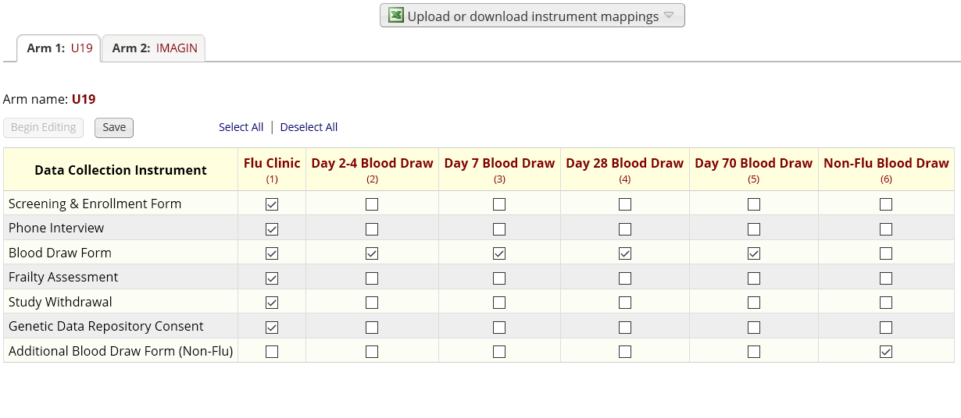
How to Designate Instruments to Events
The event list and instrument mappings can be downloaded from one project and uploaded to another project.
Notes:
After events are set up, designate instruments to each event. If you do not designate instruments to events, your instruments will not be available for data entry. The event list and instrument mappings can be downloaded from one project and uploaded to another project.

Slide 46
How to Set Up a Survey
Enable any form as a survey in On-line Designer
  Open survey setting
  Configure the survey
Survey features:
  Schedule automated survey invitations
  Set up a survey queue
  Create unique login code for survey respondents
  Set up researcher notifications upon survey completion

Slide 47
How to Send Surveys to Participants
REDCap FAQ
Surveys
  Public link: survey must be the first form. Record will be created as each survey is completed
  Designate an email field for sending survey (recommended method)
  Add participants to ‘Manage survey participants’ page
REDCap has many advanced features that can be used for setting up surveys.
This will be covered in the survey training.

Slide 48
How to Set Up your Project
Notes:
Now that you have set up the forms and the events. The next step is to set up optional modules.

Slide 49
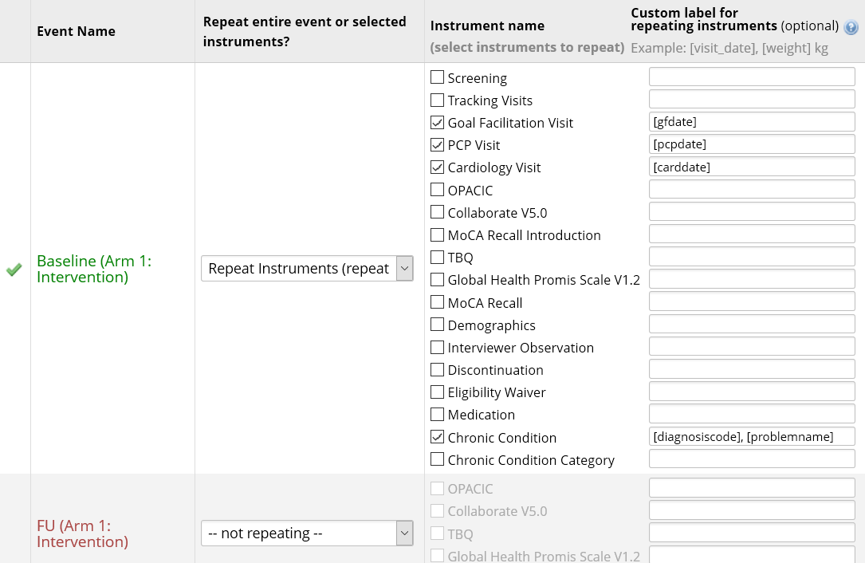
Optional Modules: Repeatable Instruments
REDCap can repeat a data collection instrument or an entire event an unlimited number of times without having to pre-specify the frequency.
Notes:
REDCap has the ability to repeat a data collection instrument or an entire event an unlimited number of times without having to pre-specify the frequency. Here in this example, the visit forms and the chronic condition form were set to repeatable.

Slide 50
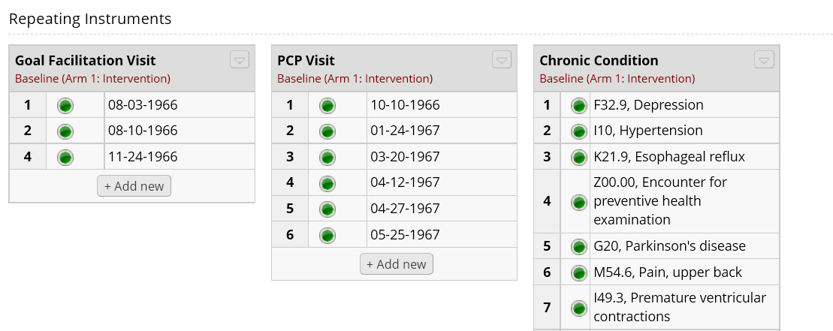
Optional Modules: Repeatable Instruments
REDCap FAQ
Project Design
Repeatable instruments shown on record home page:
Notes:
The visit dates are set as labels for the visit forms and for the chronic condition form, the diagnosis code and description are set as labels.

Slide 51
QUESTIONS?

Slide 52
FINAL STEPS BEFORE IMPLEMENTATION:
USER RIGHTS AND TESTING

Slide 53
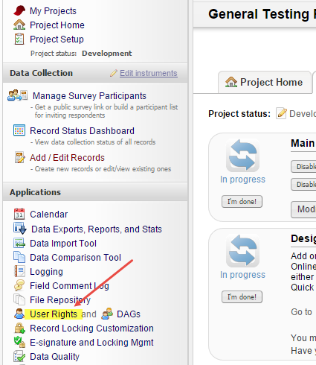
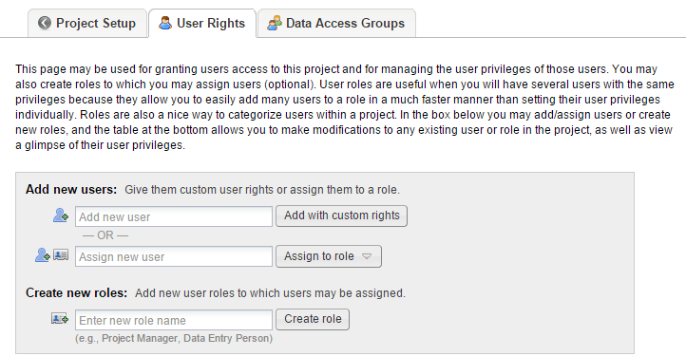
Granting User Rights in REDCap:
Individual Users
REDCap FAQ
Data Security & Protection
User access can be set up by “Custom Right” or “Role Based” access
Best Practice: “Role Based” access

Slide 54
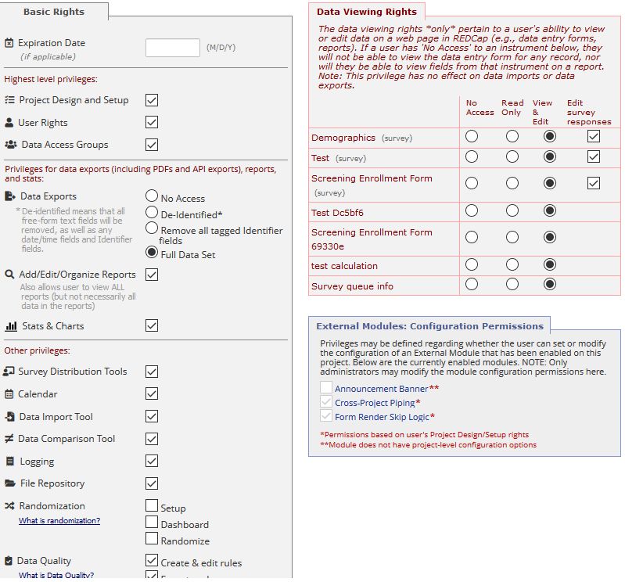
Granting User Rights in REDCap:
Individual Users
Basic Rights = Access to the Project
Data Viewing Rights = Access to Individual Forms
Exporting data is NOT linked to Data Entry Rights. User with Full Export Rights can export ALL data from the data collection instruments.

Slide 55
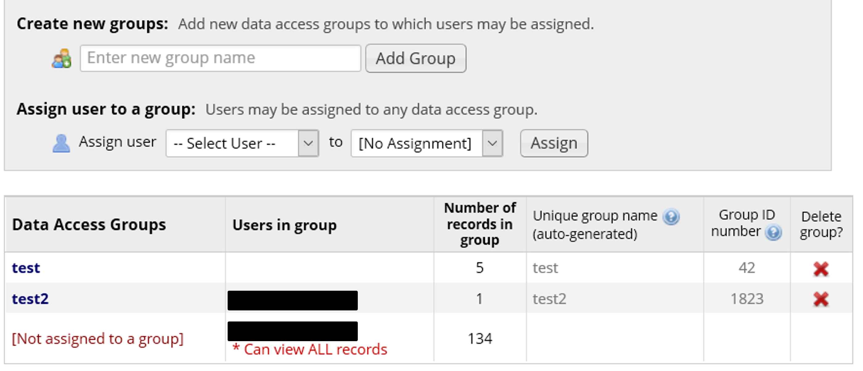
Granting User Rights in REDCap:
Data Access Groups (DAGs)
REDCap FAQ
Data Security & Protection
“Data Access Group” is an advanced feature that is useful for multi-center trials and collaborations, especially for HIPAA compliance.
Users in a particular Data Access Group can only see records entered by other users in that Data Access Group
Notes:
Users not assigned to data access group will be able to see all records. Users can be assigned to more than 1 DAG using the DAG Switcher setting in REDCap

Slide 56
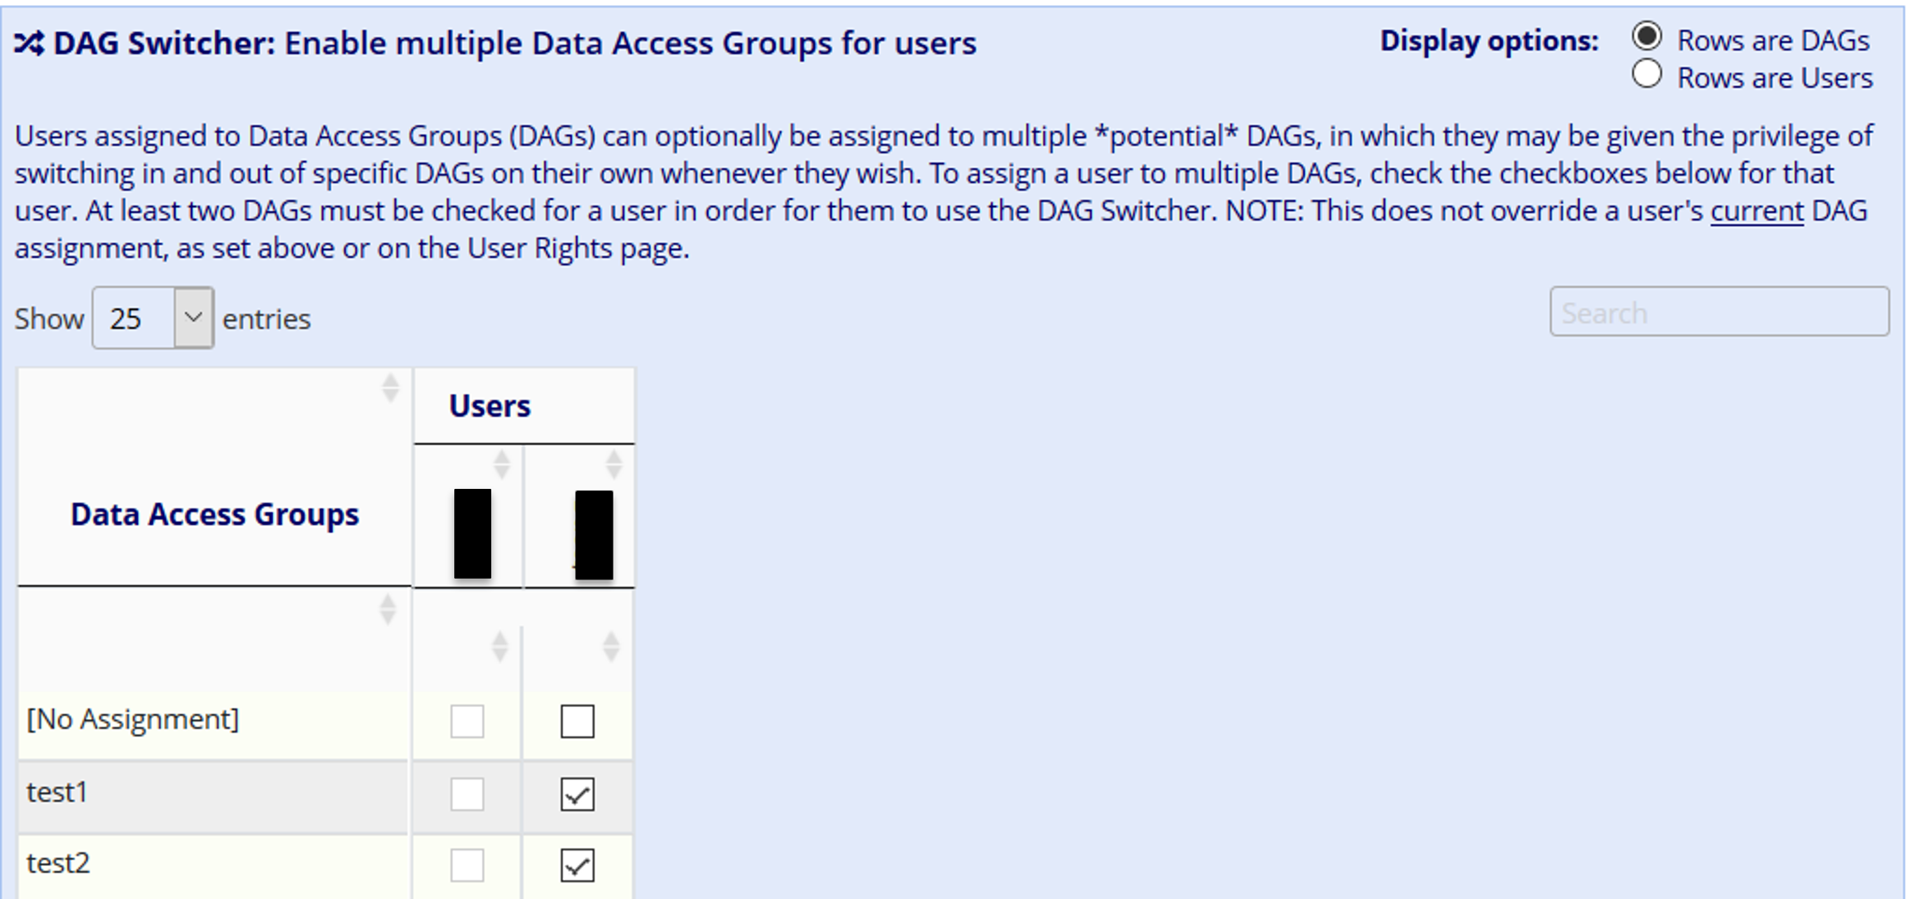
Granting User Rights in REDCap:
Assigning Users to multiple DAGs
Users can be assigned to more than one DAG using the DAG Switcher setting.

Slide 57
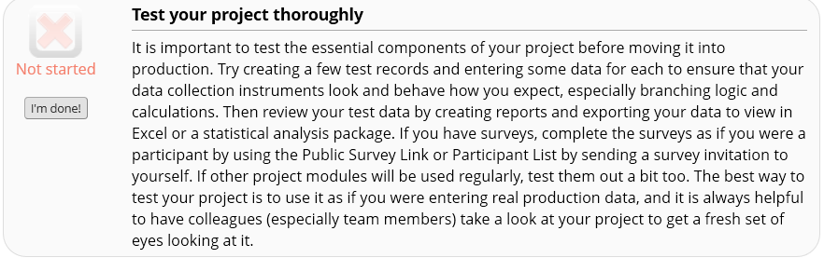
Testing your Project
Testing, Testing, Testing!
Make sure you test your project thoroughly by entering test data. Have other users enter data or complete surveys. Also export the test data to make sure the format can be used for data analysis.

Slide 58
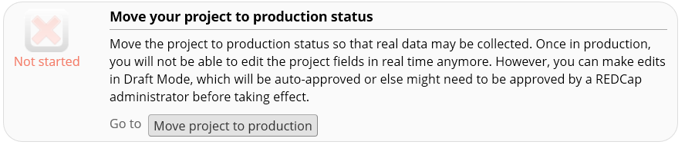
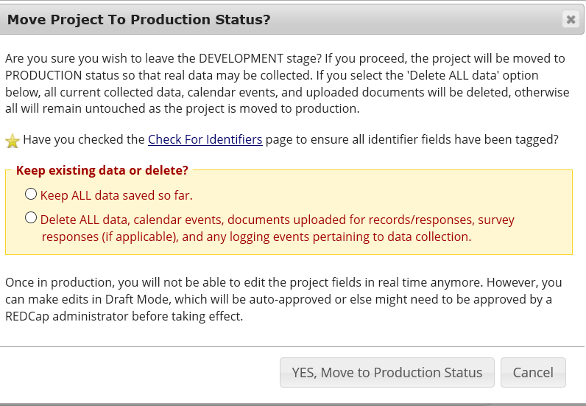
Moving your Project to Production
Notes:
When you are ready to collect real data, you can move the project to production. You will be asked if you want to keep the existing data or delete all the test data. Make sure to select the correct choice then click move to production.

Slide 59
QUESTIONS?

Slide 60
Using Data Exports, Reports and Stats

Slide 61
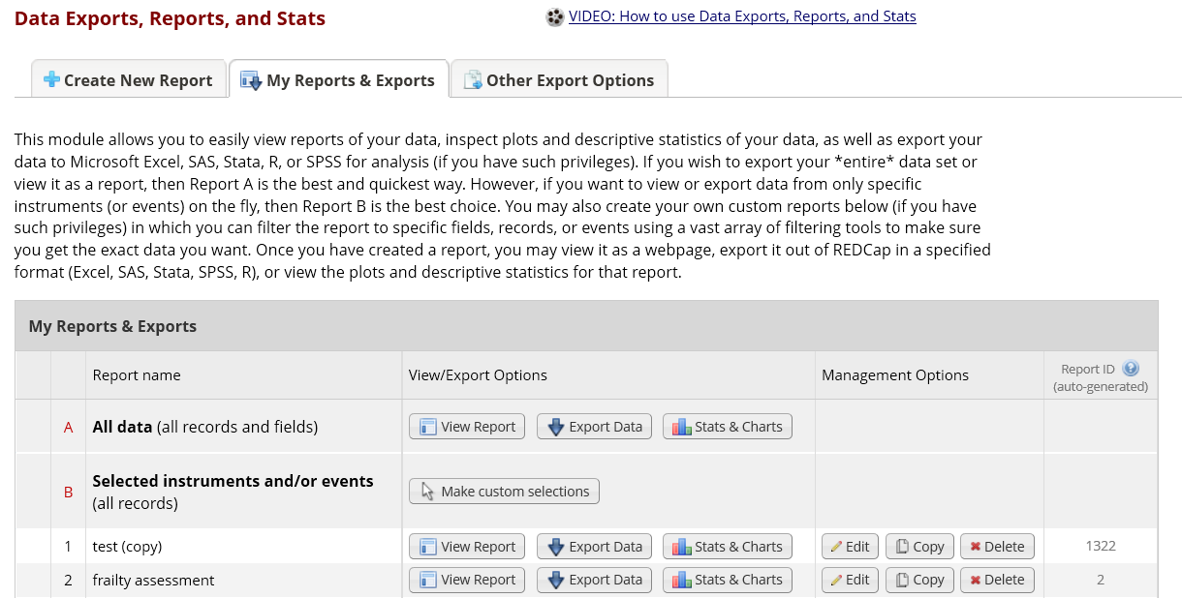
Exporting Data
REDCap FAQ
Data Security & Protection
You can export the entire dataset or select forms/fields

Slide 62
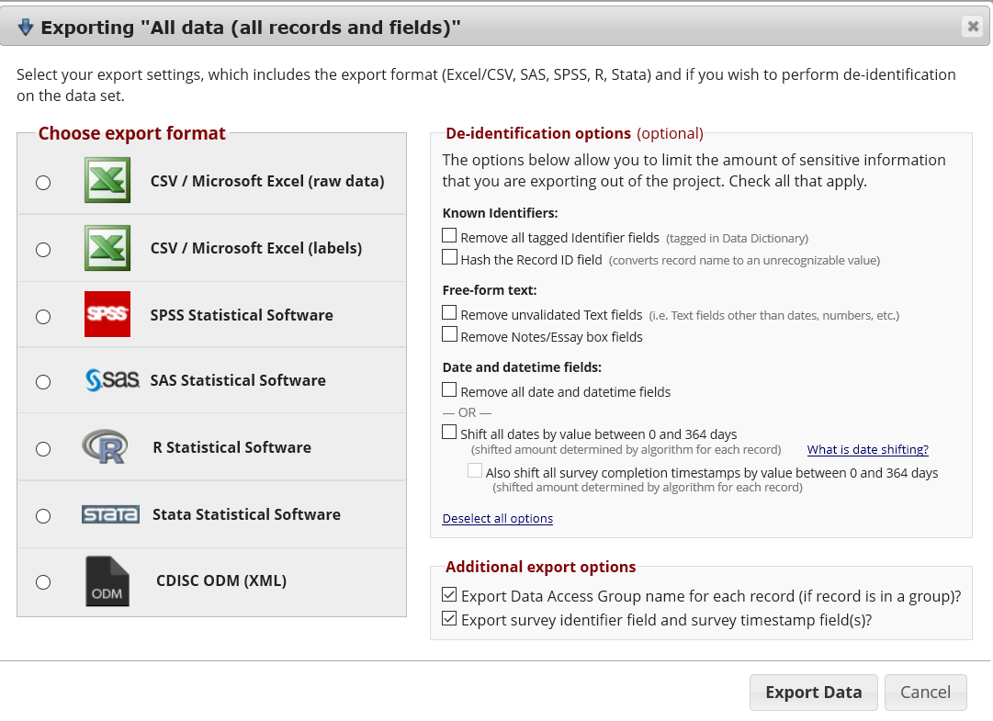
Exporting Data
Notes:
Export format- CSV, SAS, SPSS, R and STATA. You also have options to de-identify your data but this only works if you tag your identifiers as I described earlier.

Slide 63
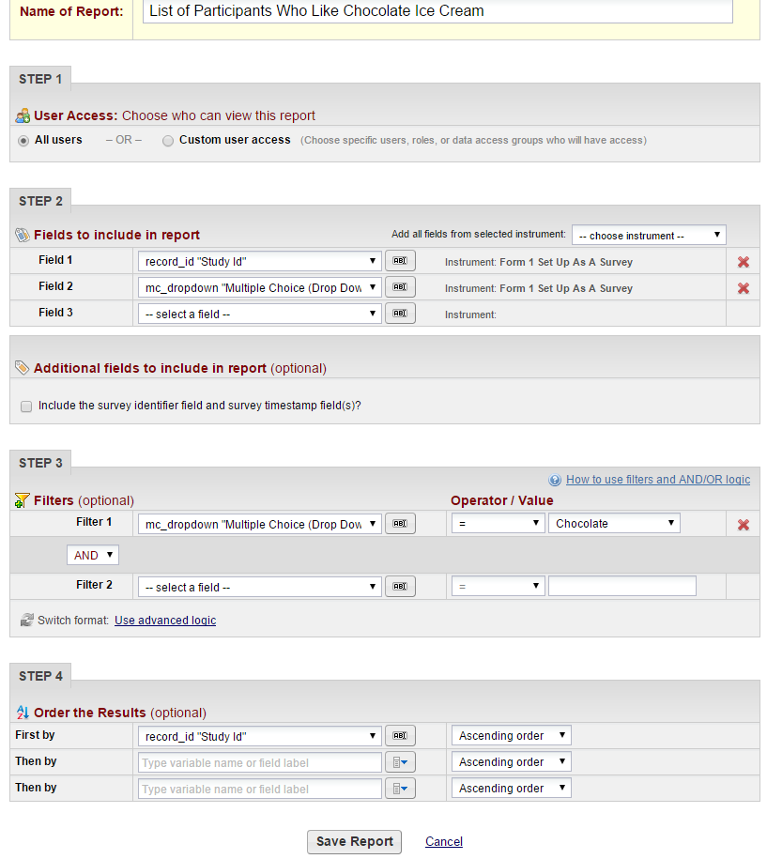
Setting Up Reports in REDCap
REDCap has many advanced features that can be used for exports and reports.
This will be covered in the Data Report, Export and Import training.
Notes:
When setting up export in REDCap, you can specify who have access to your report, select fields to include in the report. You can also set up filters and sorting orders.

Slide 64
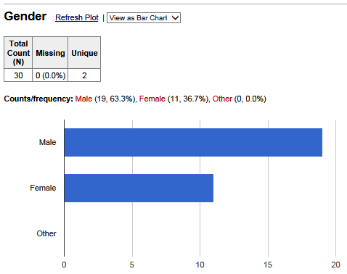



Stats and Charts

Slide 65

Data Dictionary Codebook
The Data Dictionary Codebook is a ‘human’ readable, read-only version of the project data dictionary.
You can find the Codebook link on the left menu.

Slide 66
QUESTIONS?

Slide 67
Thank You!
Further Questions: Contact us at REDCap@yale.edu

