Slide 1
Basic Project setup and management
NextGen Biomedical Informatics Center,
University of Missouri- Columbia

Slide 2
Contents
  Project Set-up
  Online Designer
  Record Status Dashboard
  Applications

Slide 3
Project setup

Slide 4
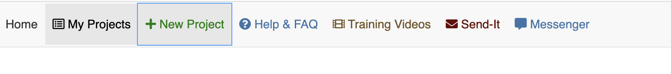
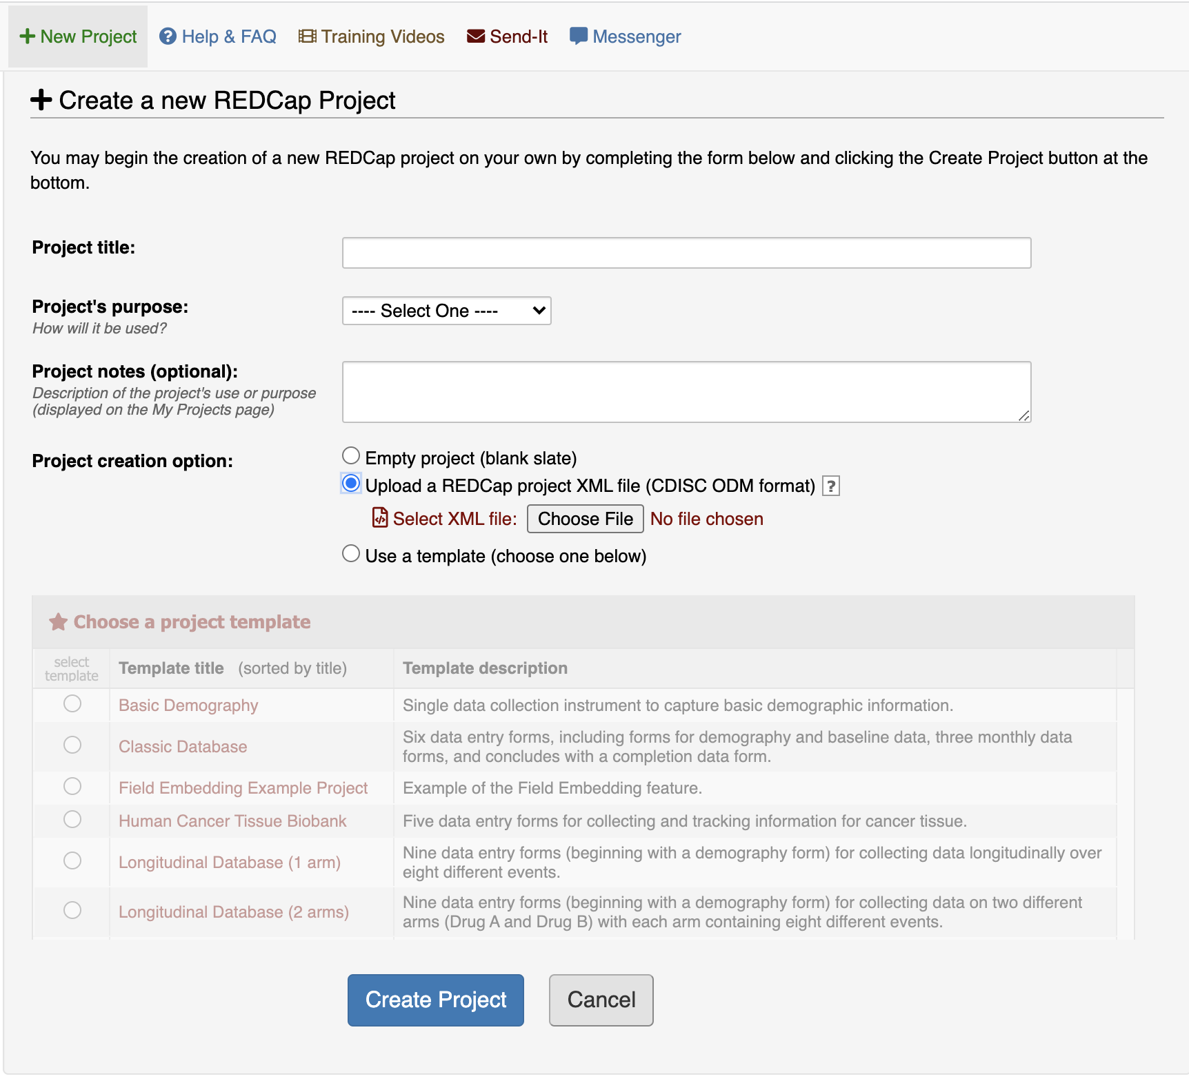
How to import a REDCap project
In the right top bar click on the new project
A separate window will open, in the project creation option select upload a REDCap XML file to import a project
Make sure to name the project and click on create project which is located in the bottom

Slide 5
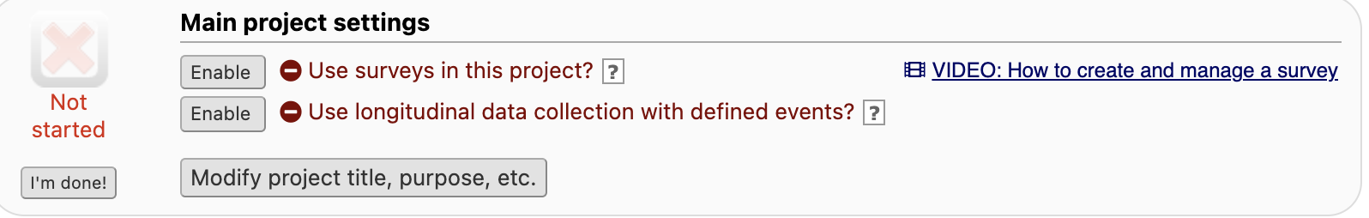
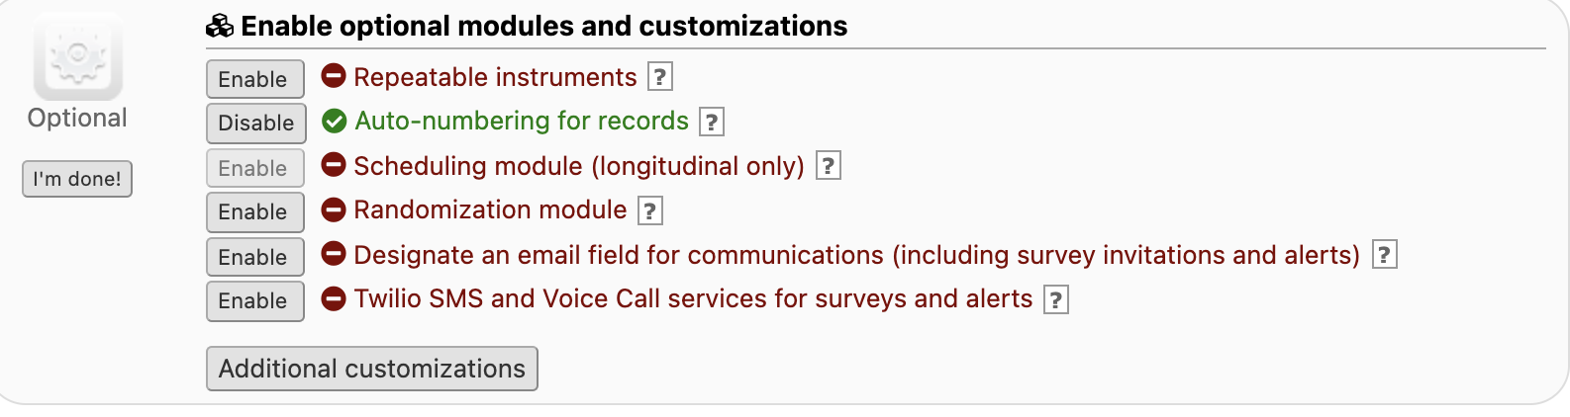
Project Set up
To modify the project title, use the following field
Additional customizations like modifying the REDCap ID/ label, adding secondary unique fields can be done using “Additional customizations ”

Slide 6
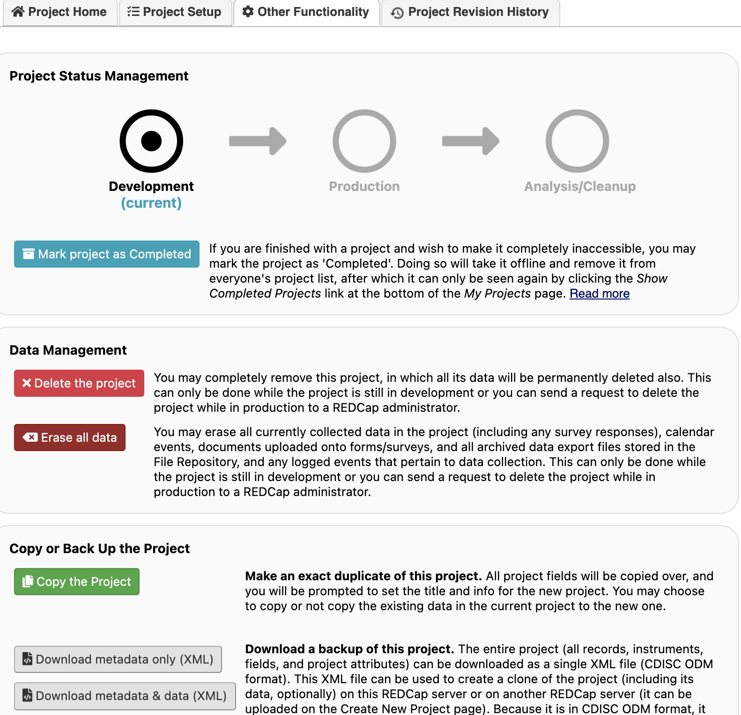
Project Set up
Other functionality in Project set up has features like
Copying the project
Deleting the project
Erasing the data

Slide 7
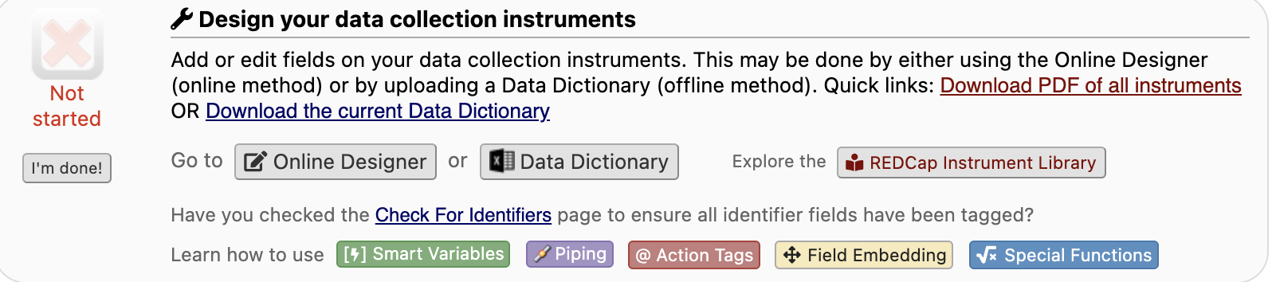
Online Designer
In the project setup page to change any variables or format of the database, select “online designer”
Click on the form you wish to modify
Variables can be edited, changed/ removed
Whenever a variable is modified make sure to change the embedded field name in the respective table
Note: More about the Field embeddings, smart variables, piping and other features are available in the REDCap tutorials

Slide 8
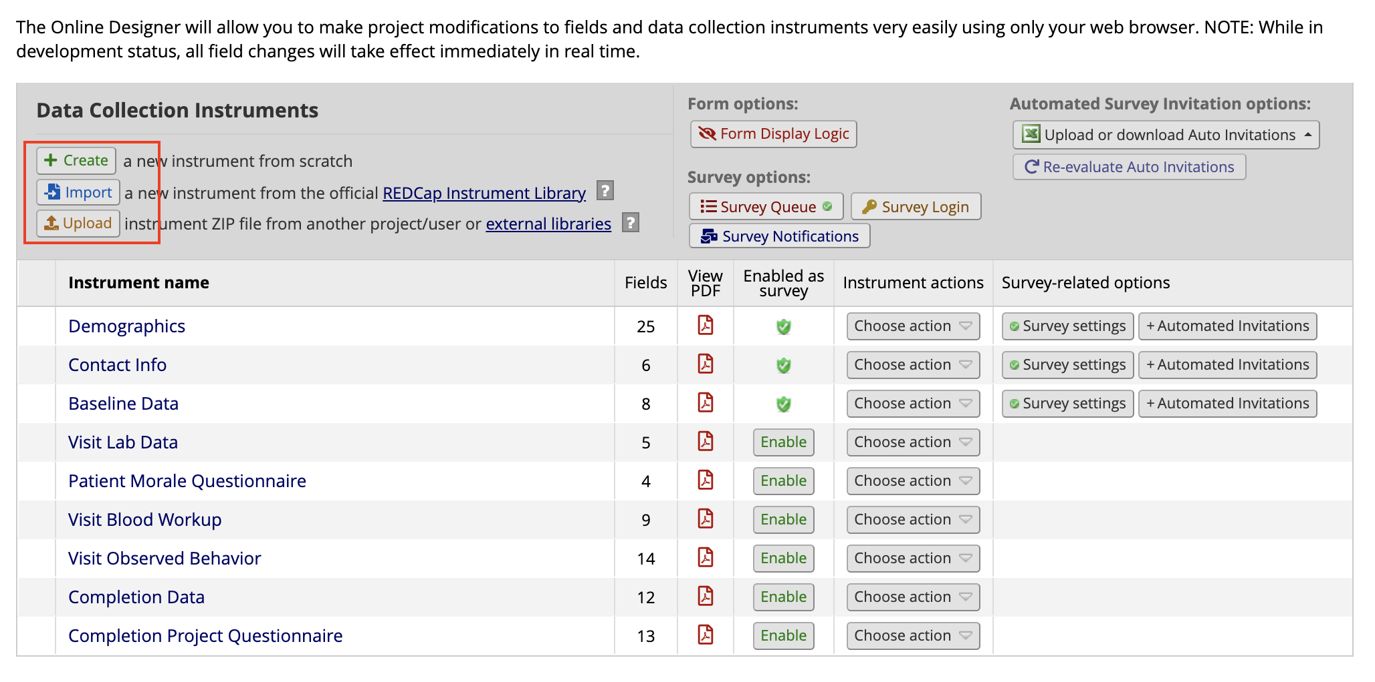
How to download/create/import Instruments
Instrument in the REDCap is a form and multiple instruments can be created in a project
Using “Choose action” dropdown instrument/form can be renamed, copied, downloaded (as Zip) or deleted
Use create to add new form
Upload can be used to import form/instrument from personal computer
Import is useful to get forms from REDCap library

Slide 9
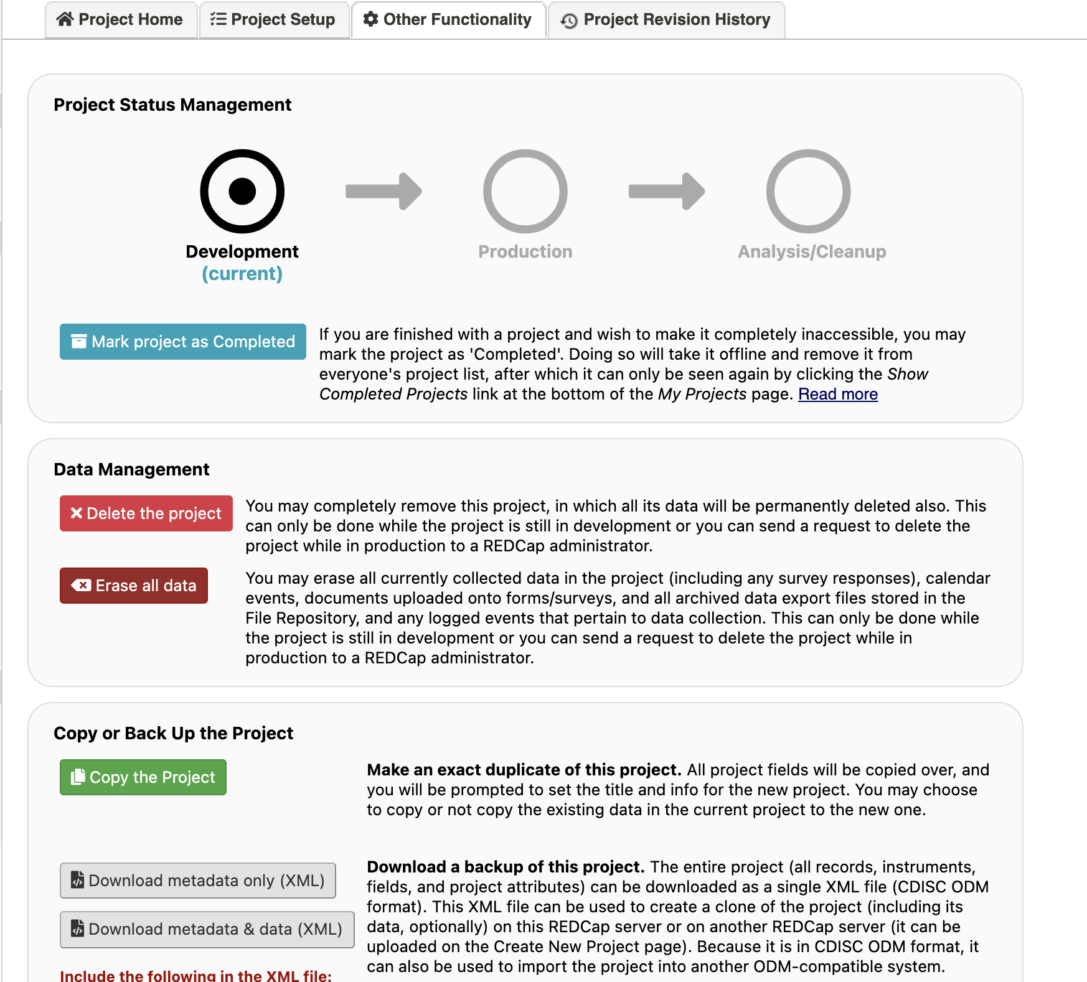
How to export a REDCap project
There are two ways to export a project
1. Project Setup:
In the project setup page go to other functionality. After scrolling little below you will get to “copy or backup the project”. Choose the backup options, either downloading the metadata xml with data or without

Slide 10
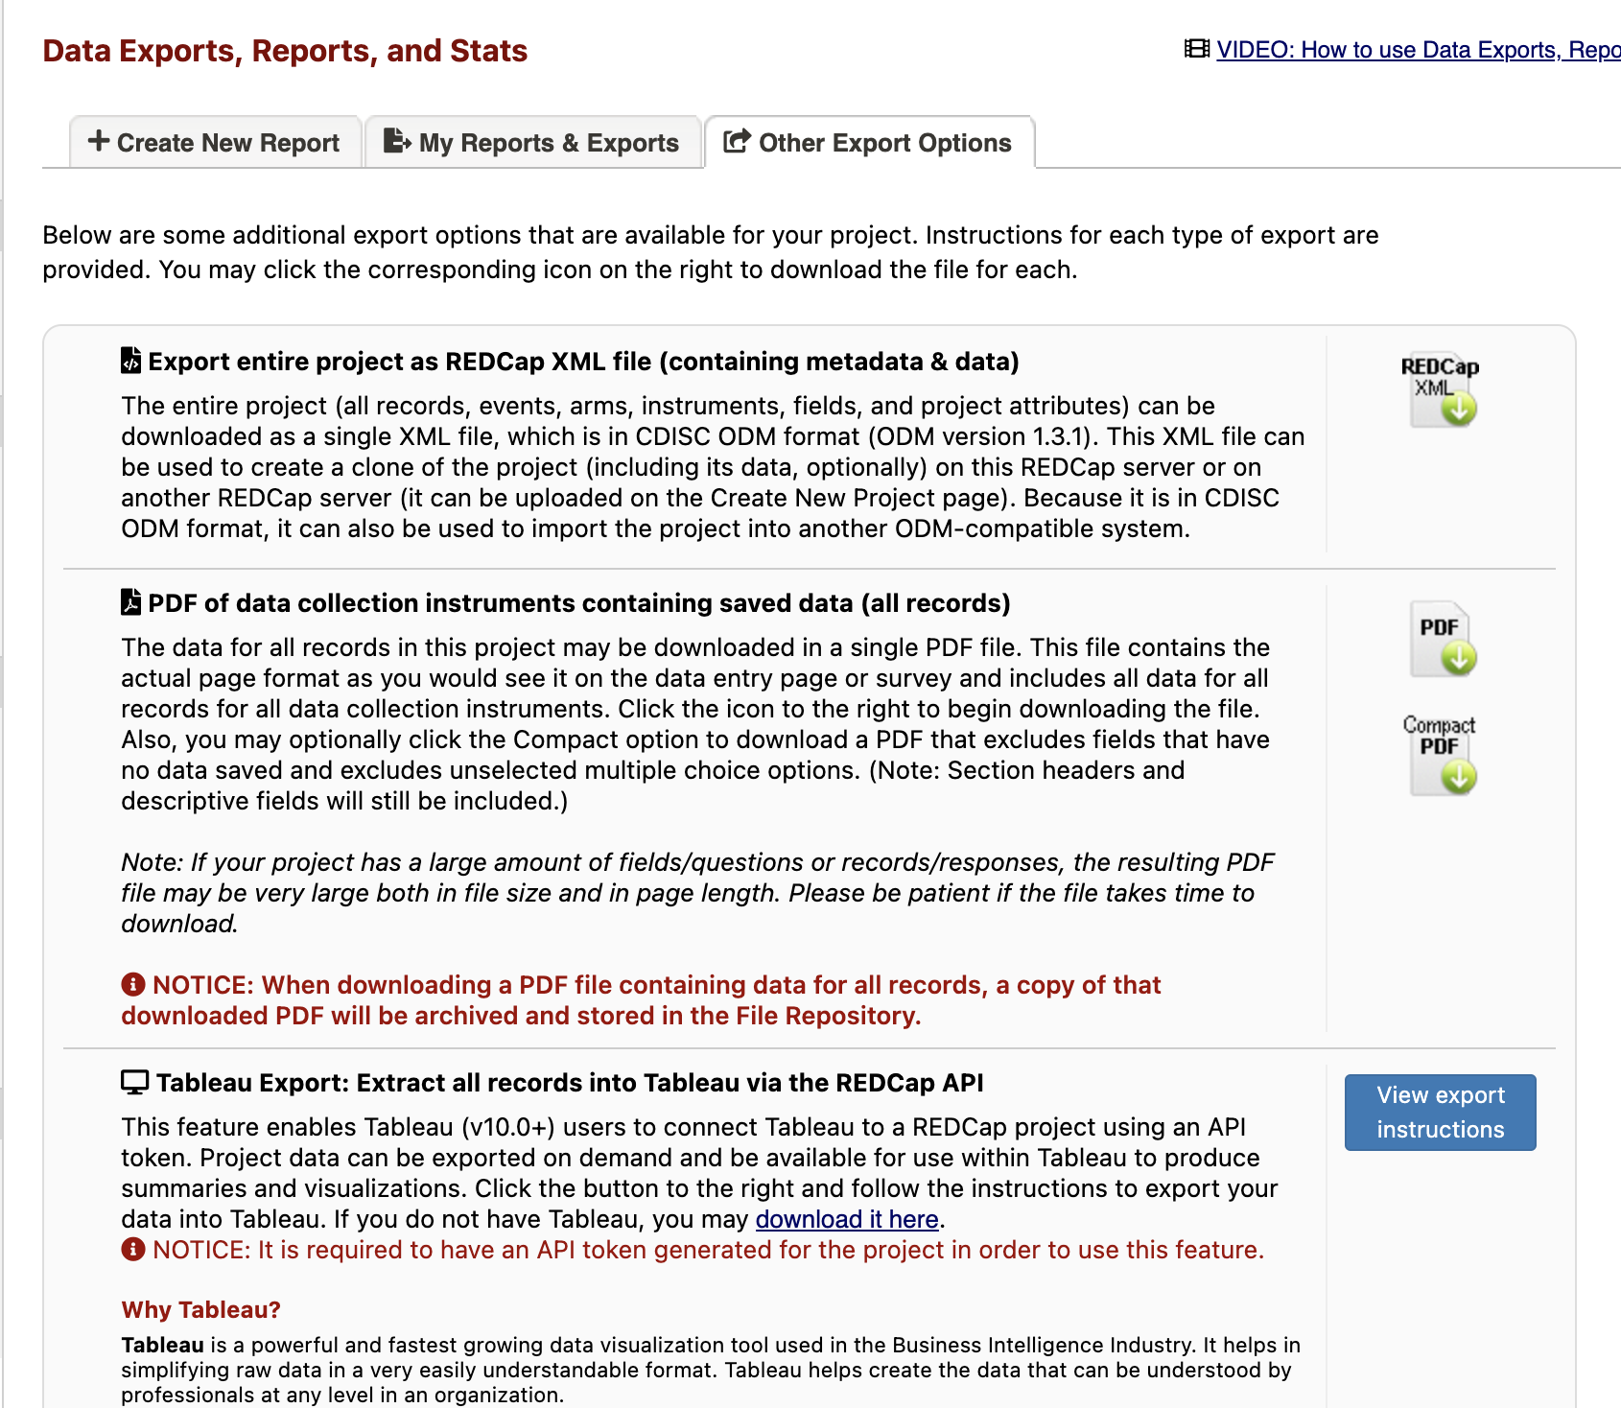
How to export a REDCap project
2. Data exports, Reports and Stats:
In the data exports, reports and stats page go to other exports options. Few options will appear choose which a suitable one

Slide 11
Record status dashboard

Slide 12
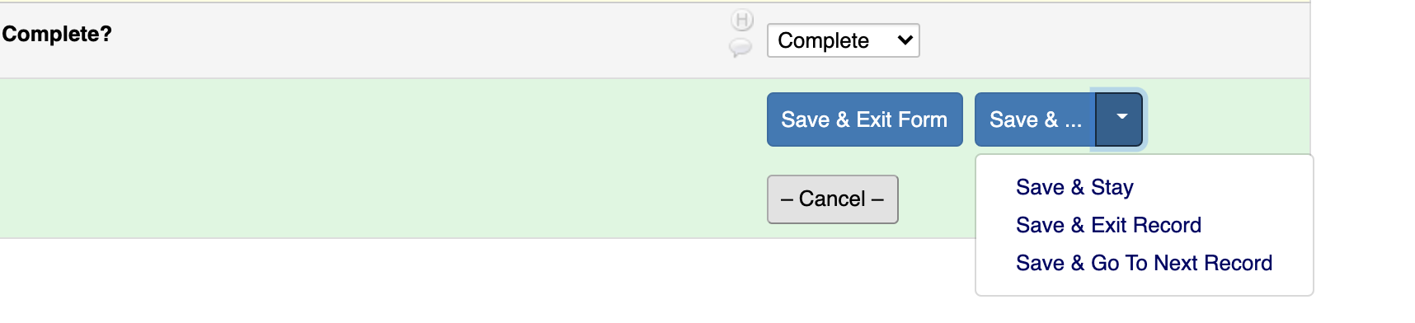
Record Modification
Open the record you want to modify, edit the fields and click on either of the three options as shown in picture

Slide 13
How To Download The Record

Slide 14
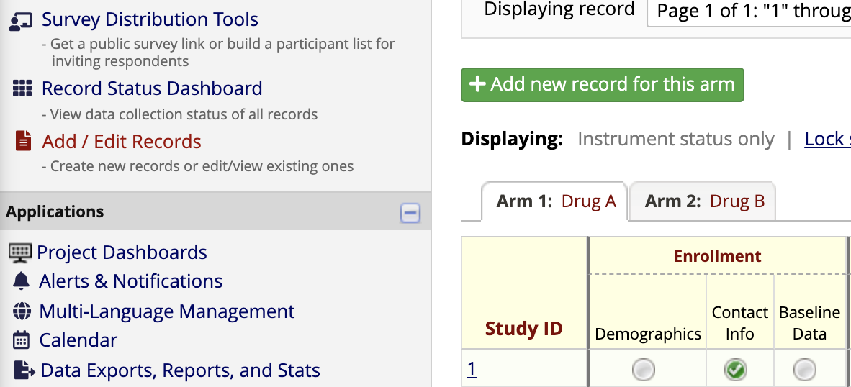
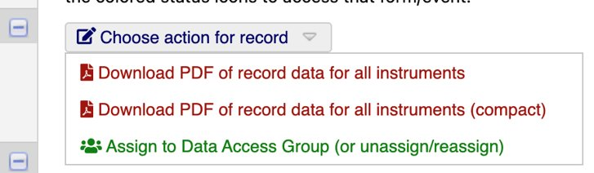
Downloading A Record (all Instruments/Forms)
Step-1: To download data of record from all instruments, click on the record number​
Step-2: After record is opened from "choose action for record" select appropriate option​

Slide 15
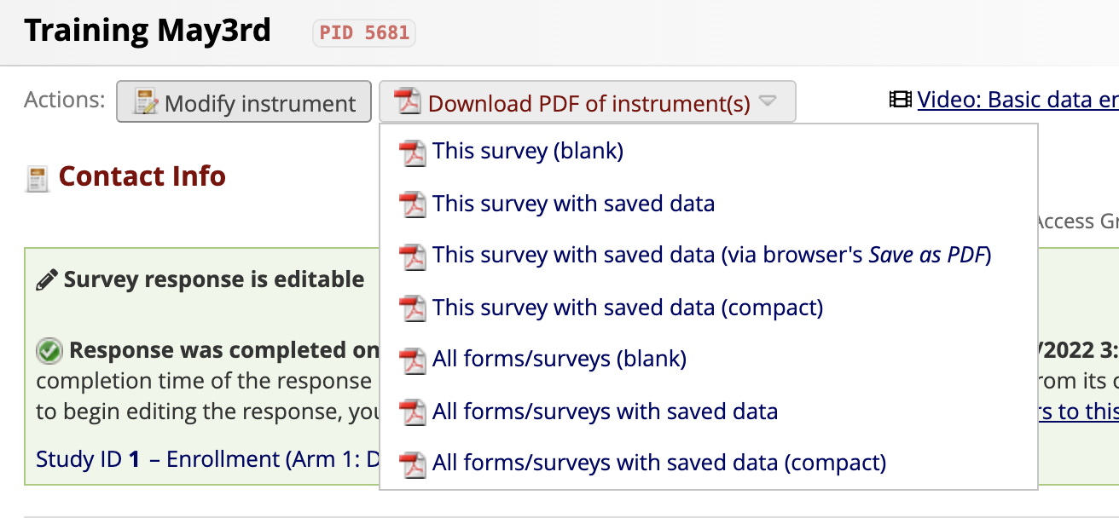
Downloading A Record (One Instrument/Form)
A single instrument/ form can be downloaded using "Download PDF of Instrument​" which is located at the top

Slide 16
How To Delete Records

Slide 17
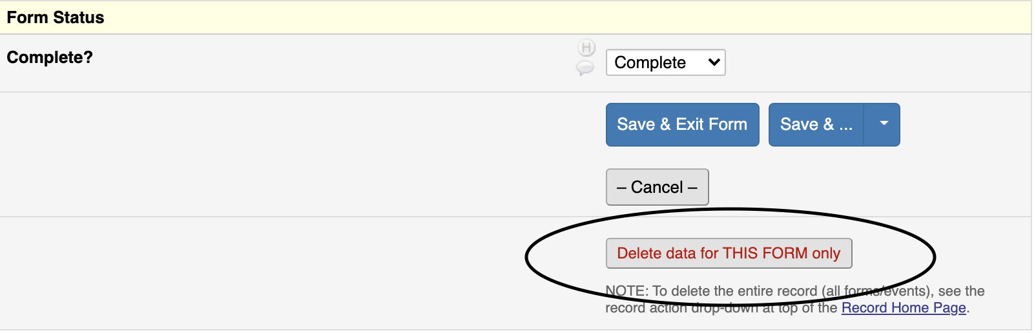
Approach 1
Forms of a record can be deleted individually from the record status dashboard ​
Please select the form you wish to delete and scroll all the way down​
Select "Delete data for THIS FORM only" as shown in the picture

Slide 18
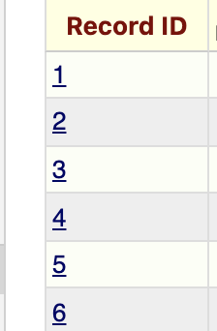
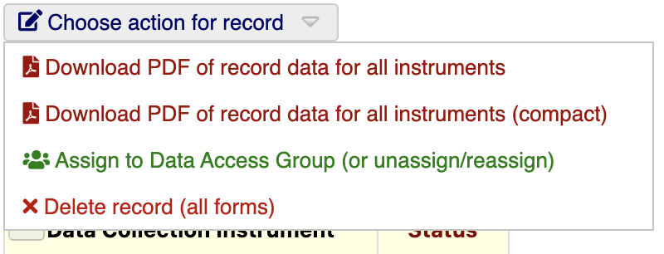
Approach 2
To delete all the forms/ entire record click on the "Record ID" as shown in the picture ​
From "Choose action for record" dropdown menu select "Delete record (all forms)"

Slide 19
REDcap Applications

Slide 20
How To Import Data

Slide 21
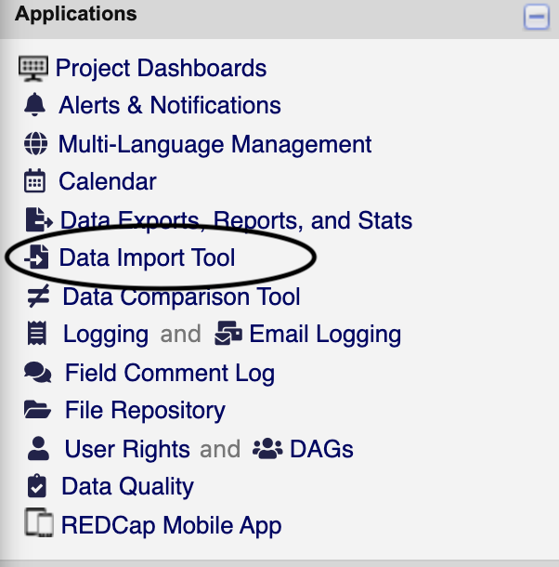
Step 1
Go to the project where you wish to import data
Under applications open “Data Import Tool”

Slide 22
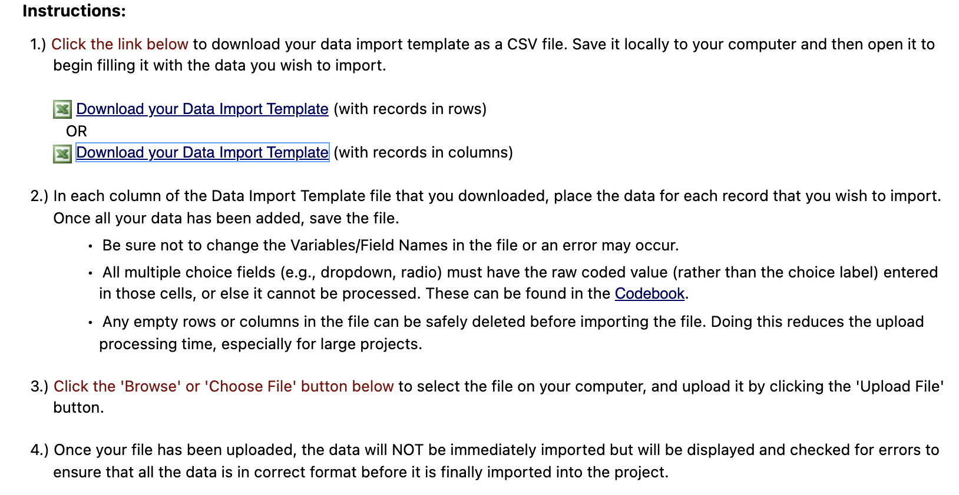
Step 2
Download the data import template format and use the same field names as seen in template ​
Make sure “record id” is continuous, not duplicated and mention the user DAG name appropriately​

Slide 23
Step 3
Read instructions thoroughly

Slide 24
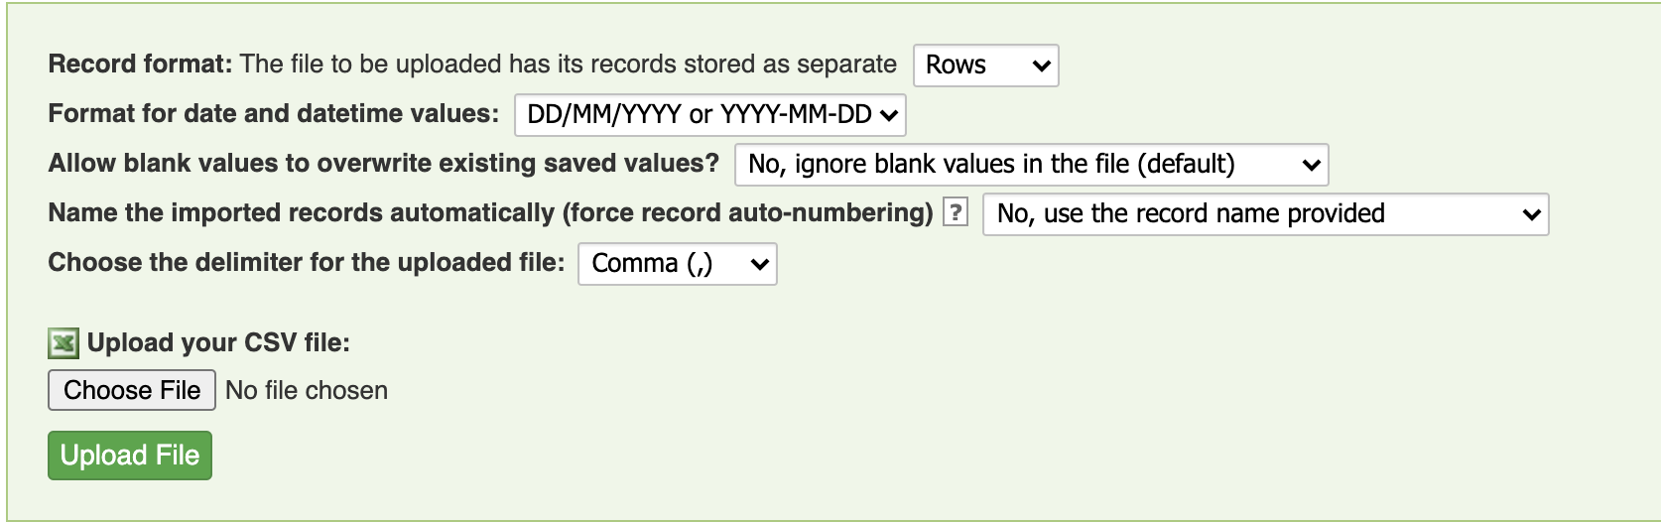
Step 4
Make sure all the fields are designated properly and upload the file
Fix errors before training again

Slide 25
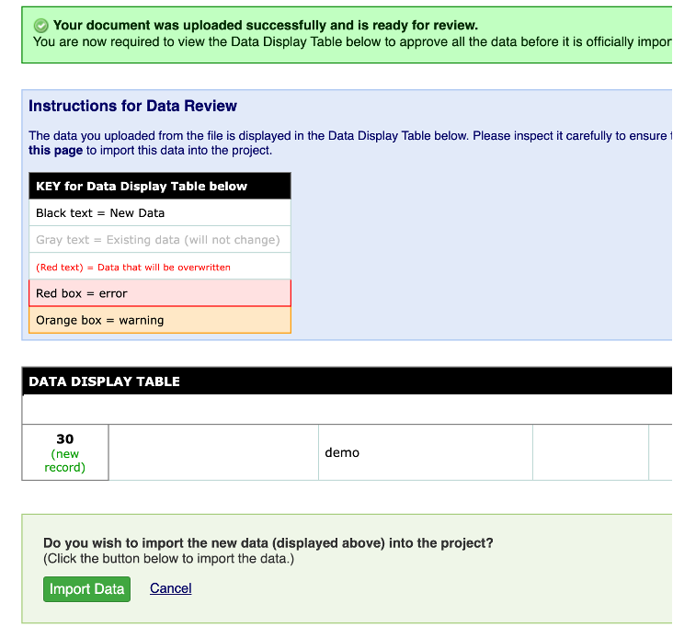
Step 5
Review the data before importing

Slide 26
CSV Template for Data Import

Slide 27
Step 1
Open the project where you want to get the CSV template from and under applications open “Data Import Tool”

Slide 28
Step 2
Download the data import template and use the same field naming as in template

Slide 29
How TO EXPORT DATA

Slide 30
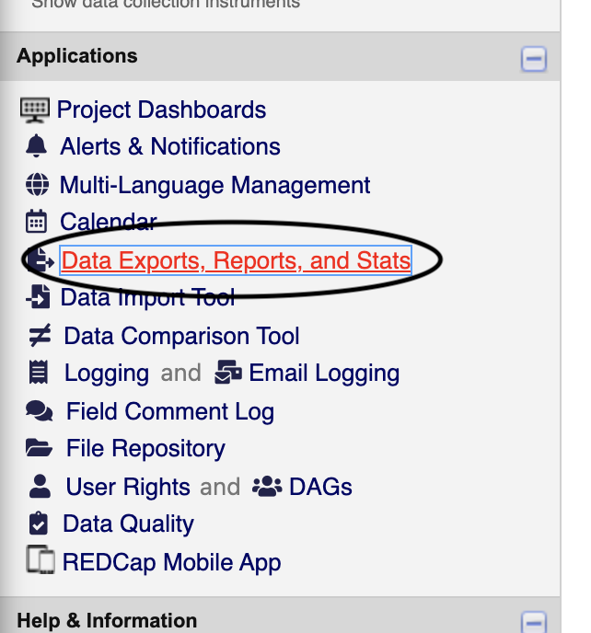
Step 1
Under applications open “Data Exports, Reports, and Stats”

Slide 31
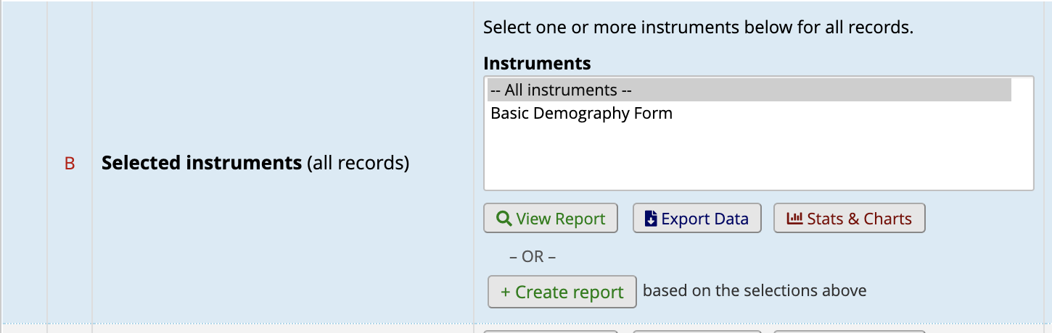
Step 2(a)
Click on “All data- Export data” if you would like to get csv for all the instruments

Slide 32
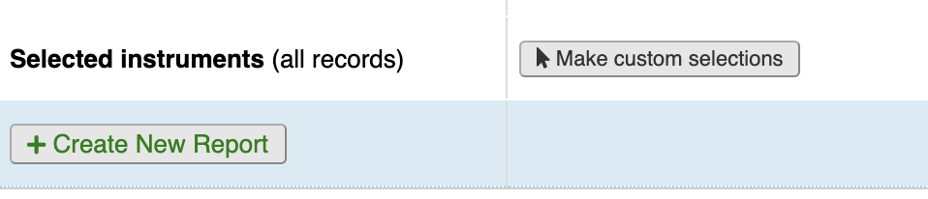
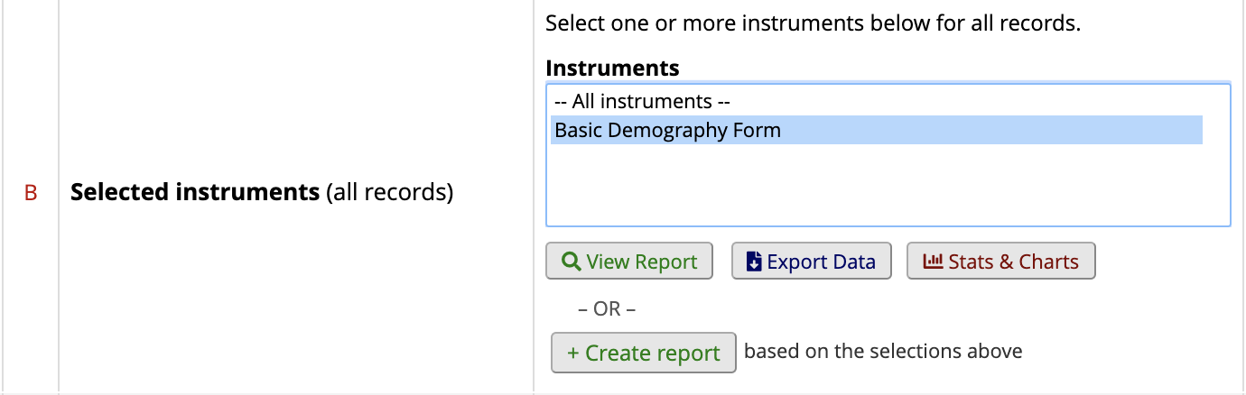
Step 2(b)
Click on “Selected instruments - Make custom selections” if you would like to get csv for a particular instrument

Slide 33
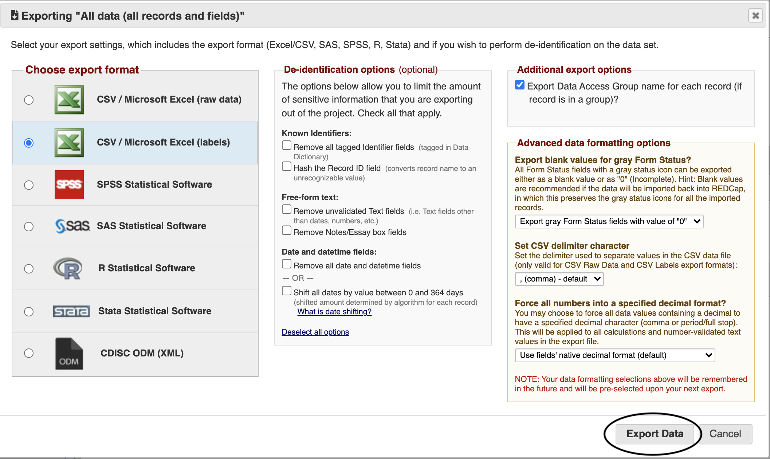
Step 3
Select desired format, de-identified options, additional fields (if needed) and click on “Export data”

Slide 34
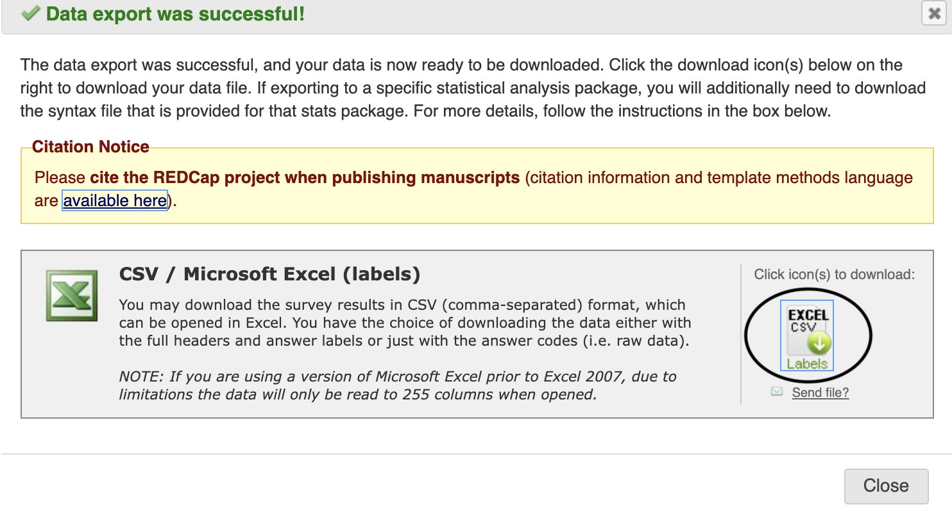
Step 4
Download the file by clicking on the download button as seen below

Slide 35
How To Add/Edit/View Reports

Slide 36
Step 1
Open the project where you want to create/edit the report
Under applications open “Data Exports, Reports, and Stats”

Slide 37
Step 1
Click on “Create Report” to add new report
To edit the report, click on edit
To delete the report, click on delete
To copy the report, click on copy
To view the existing report, click on view report

Slide 38
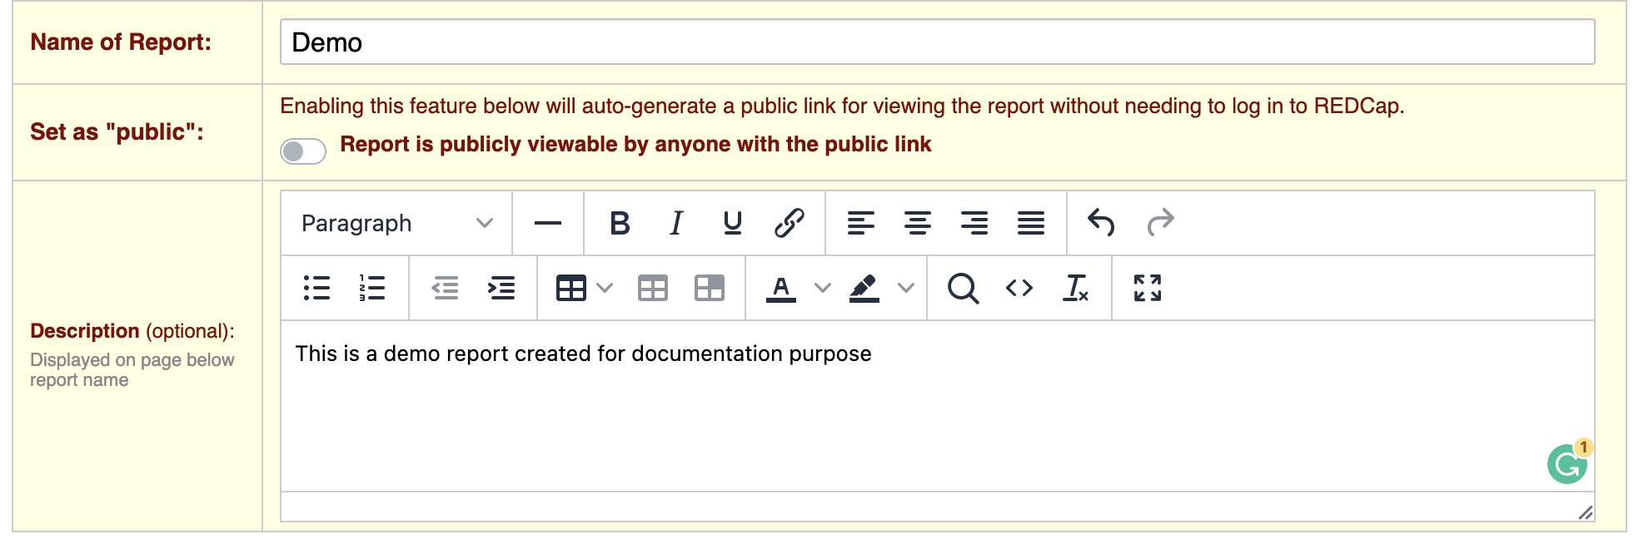
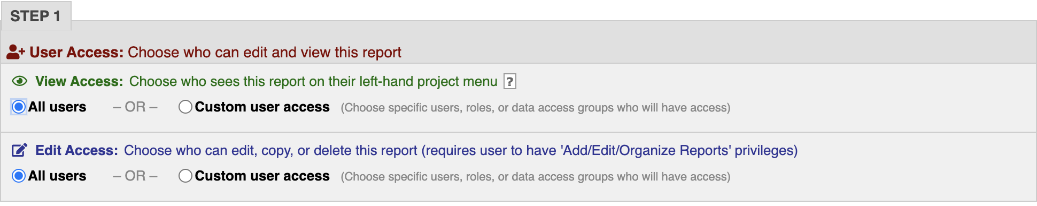
New/Create Report
Step 1: Give the project an appropriate title and description​
Step 2: Set up user access appropriately by clicking on the username. You can also choose the view and edit access independently

Slide 39
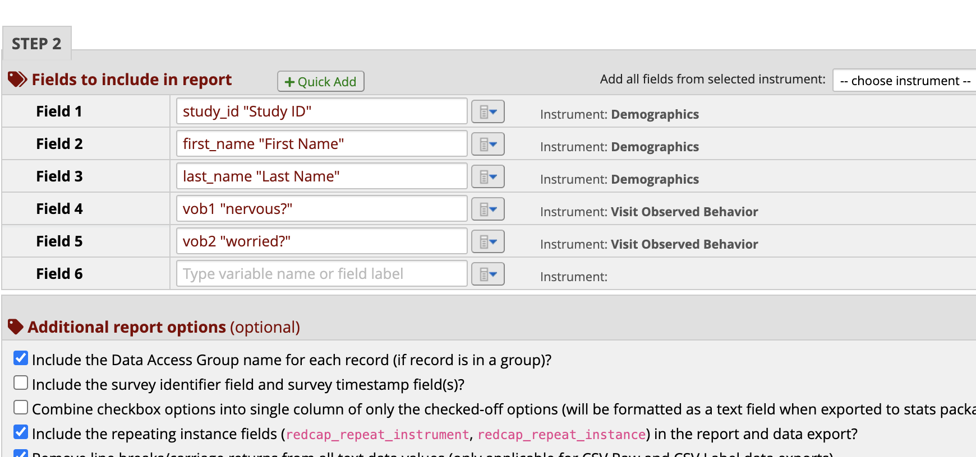
New/Create Report
Step 3: Report fields can be added using “Quick Add” or by using dropdown beside fields or by typing variable/ label name as shown in the picture
You can customize the variable’s list by choosing instrument from field shown at top right of the picture
You can also add additional fields to the report

Slide 40
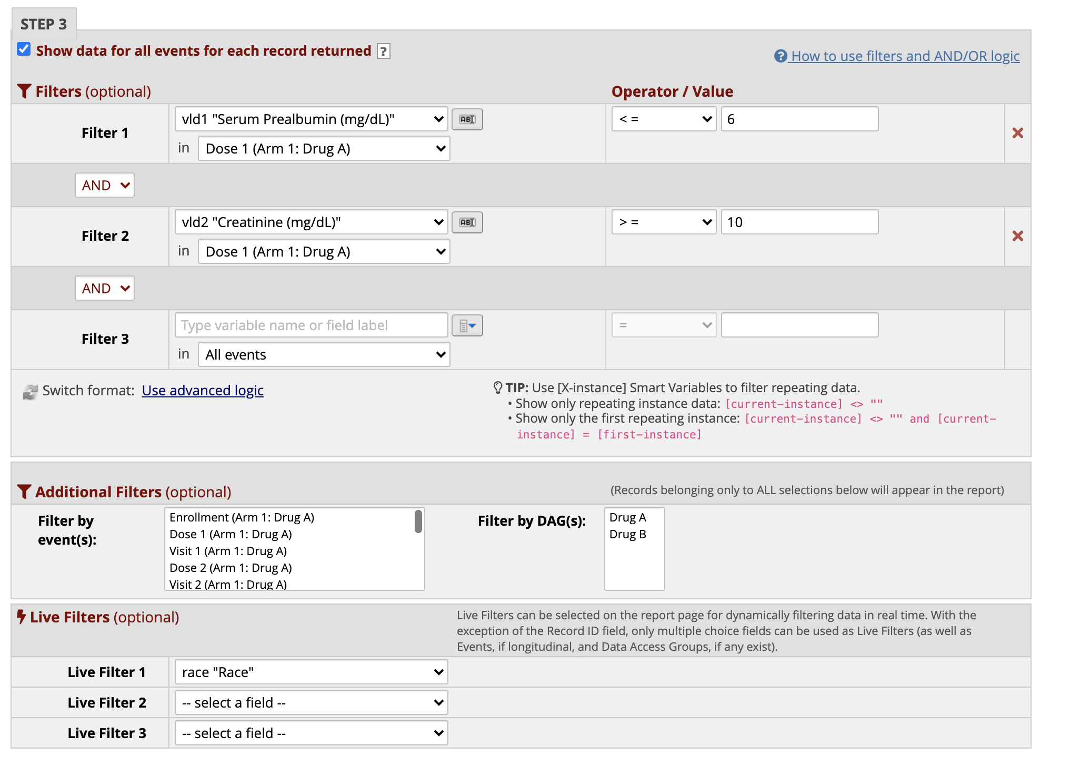
New/Create Report
Step 4: If you would like to filter report in the back end, please use filters/additional filters
Live filters are shown in the report as dropdown elements

Slide 41
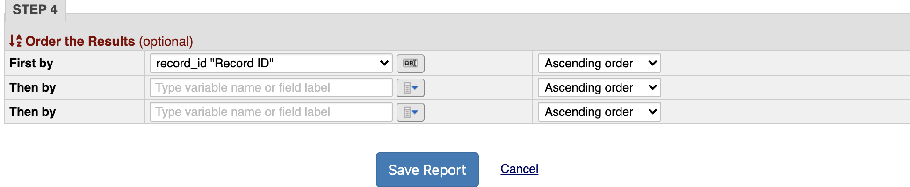
New/Create Report
Step 5: Sorting can be done using “Order results by”

Slide 42
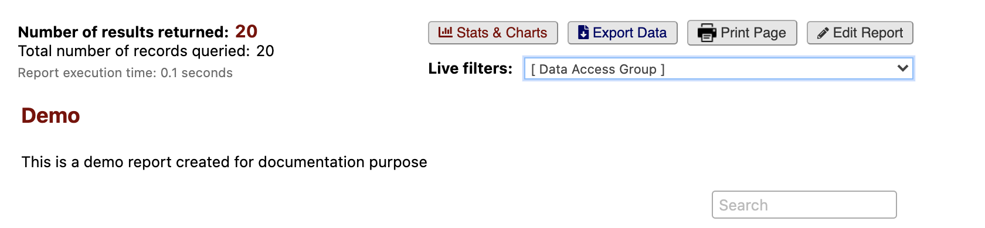
Report
Below is the picture of how a report looks

Slide 43
User Roles/User Rights/Dag’s

Slide 44
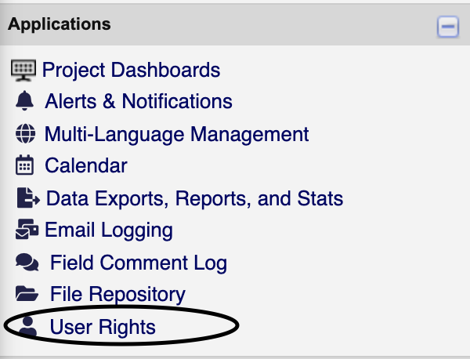
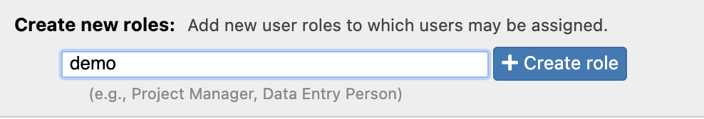
How to Create a user role?
Under applications open “User Rights”
In user rights page check for existing roles under “Role names” before adding a new ones

Slide 45
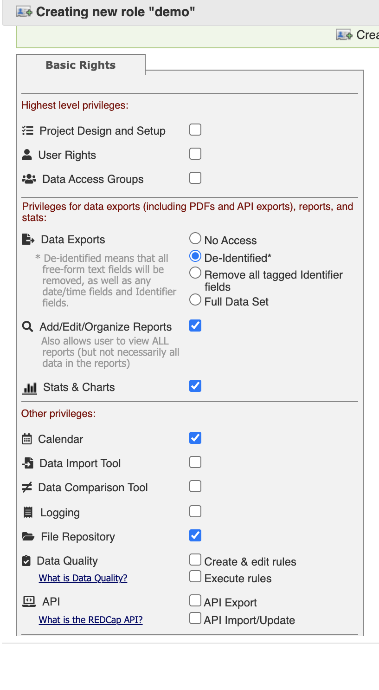
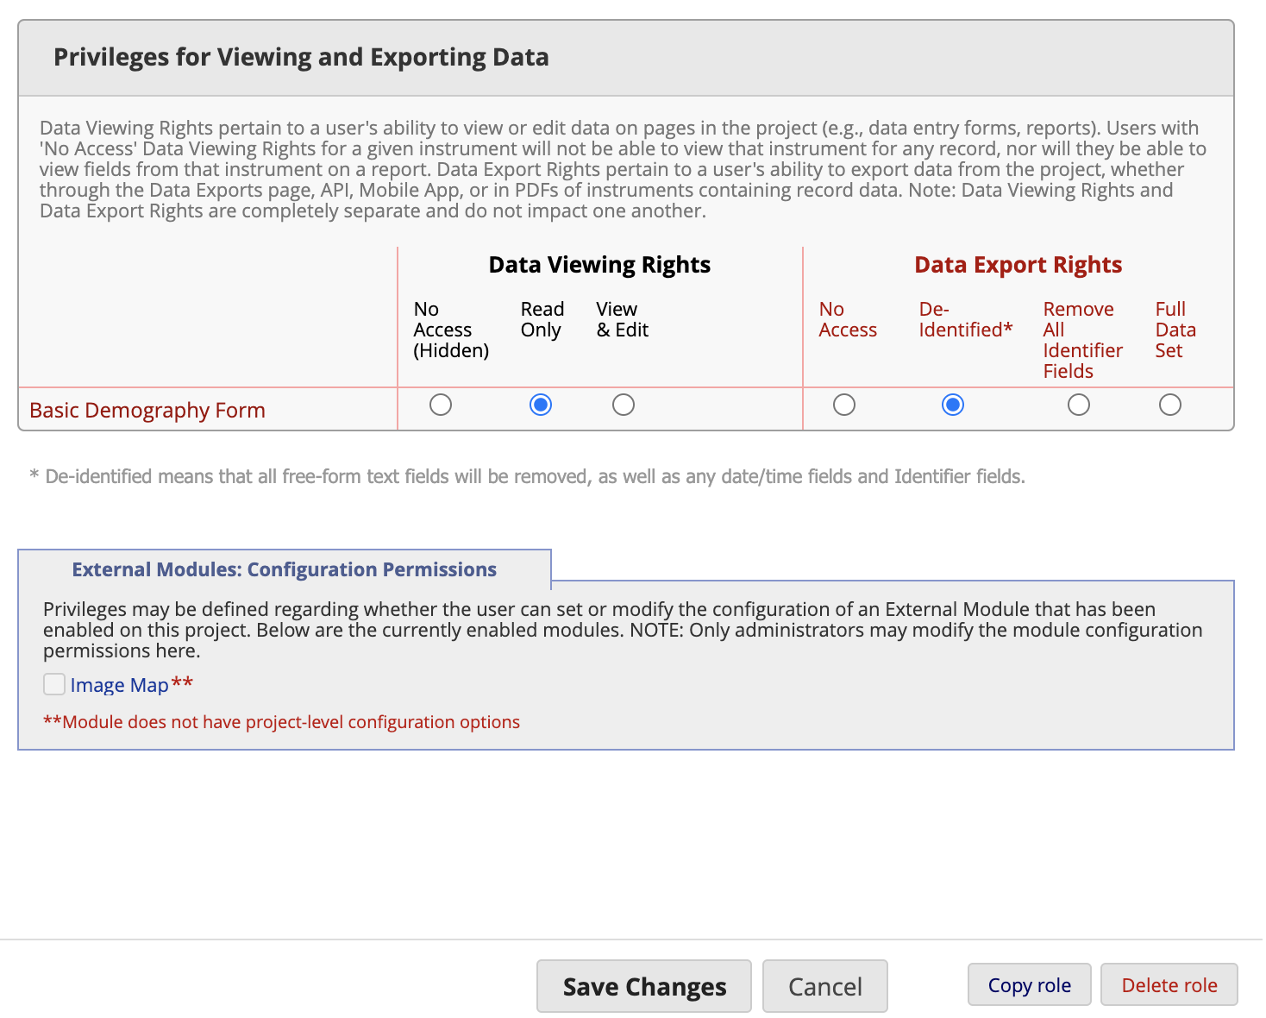
How to Create a user role?
To create a new user role, enter the name of the role in the box in front of create role and click on “create role”
A window will pop-up, choose the necessary entities you wish the role should access and click on create role

Slide 46
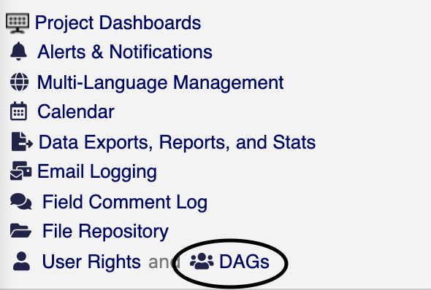
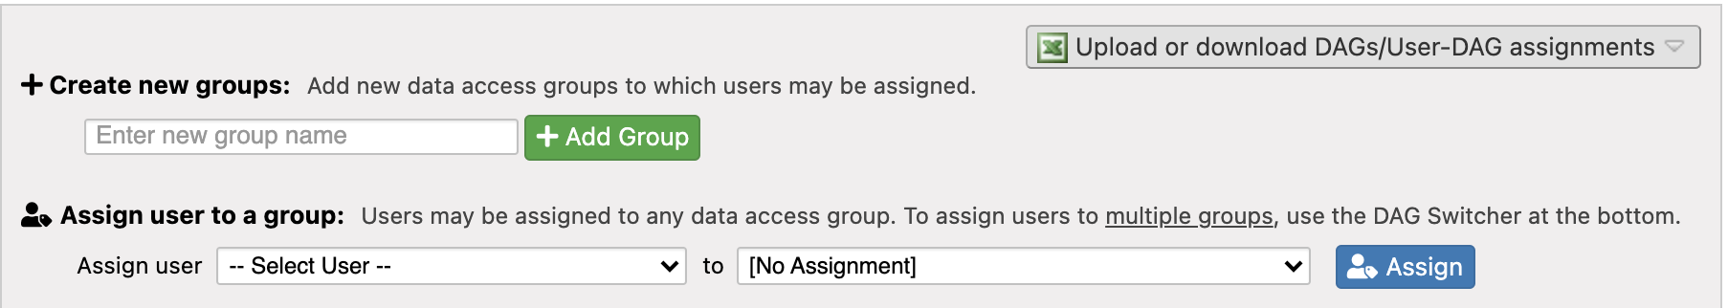
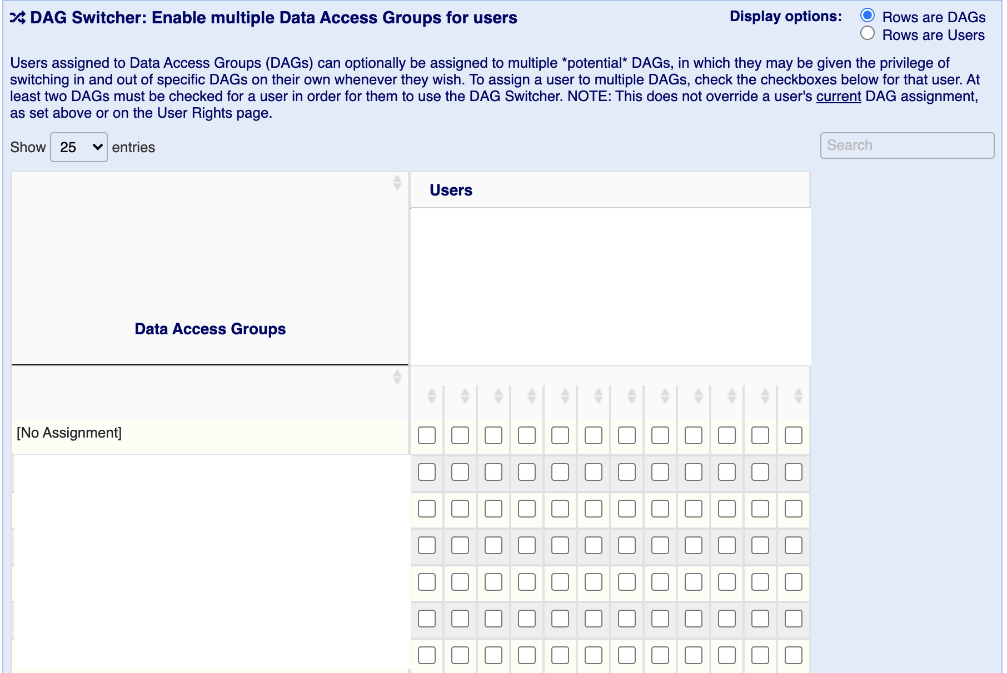
How to Create a DAG?
Under applications open “DAGs”
Check for existing groups under “Data Access Groups” before adding a new ones
To create a new DAG, enter the name of the group in the box in front of add group and click on “add group”
Make sure to add DAGs using the service delivery site name

Slide 47
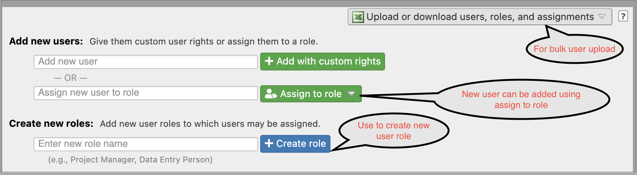
How to ADD users?
Go to “User Rights” page to add new users
If the user role already exists add user using “Assign to role”
Add user using their MDHSS REDCap User ID/Name and click on assign to role and select respective role from dropdown
To add bulk users, first download the file from top right corner and modify the file as per needs and import the file using the same dropdown
If the user doesn’t fit into any user role and you don’t wish to create a new user role add users using “Add with custom rights” and make sure to select appropriate fields from pop-up

Slide 48
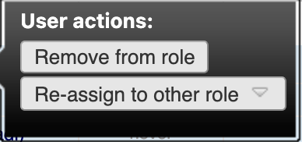
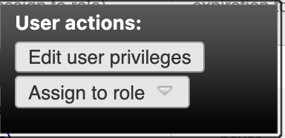

How to Modify user Rights/User Roles?
Go to “User Rights” page
If the user is under any one of the role you can reassign them or remove from the current role by clicking on their username
If the user is not under any roles, you modify the user privileges by clicking on their username
To remove the user, user should be unassigned from the role first. Then click on the username $→$ Privileges $→Click on$ “Remove User” which can be found on the left bottom corner
To change the name of User Role, click on the role name

Slide 49
How to Modify Dags AND ASSIGN USERS TO DAG?
Go to DAGs page and click on the respective DAG name you wish to change and modify
To assign a user to DAG or modify user’s DAG there are two approaches
  1(a). In the DAGs page select user and DAG from dropdown as shown in the picture and click on assign

Slide 50
How to Modify Dags AND ASSIGN USERS TO DAG?
1(b)
Users can be added/modified to multiple DAGs by using the check boxes as shown in the picture

Slide 51
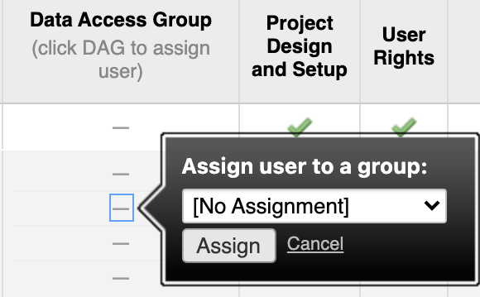
How to Modify Dags AND ASSIGN USERS TO DAG?
2. Go to user rights page and click on the already assigned DAG or “-” to modify/assign to a DAG

Slide 52
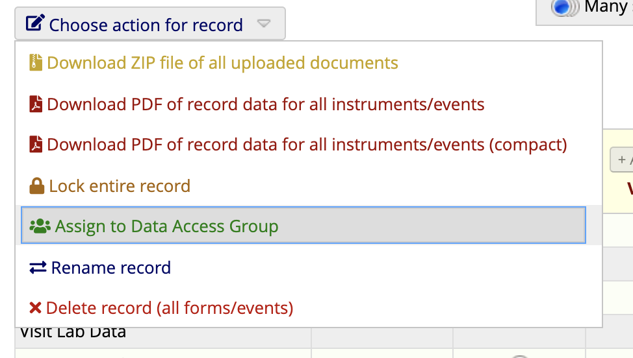
How To assign record TO DAG?
Go to record status dashboard and click on the Record ID/ Number
As shown in the picture select “assign to Data Access Group”
Note: If a DAG assigned user add records, they will automatically be added to DAG and other DAG user will not have access to these records

Slide 53

Notes
Documentation and Training of general REDCap usage is in the bottom left of every page as "video tutorials"​

