Slide 1
REDCap Training 201
REDCap Special Features and Customization
Sui Tsang
REDCap@Yale Team
2/22/2022

Slide 2
Introduction and Learning Objective
Recognize the optional modules available in REDCap
Understand alerts and notifications
Learn how to set up custom dashboard
Learn how to use data quality module
Demonstrate special functions for calculation and branching logics
Understand what external modules are

Slide 3
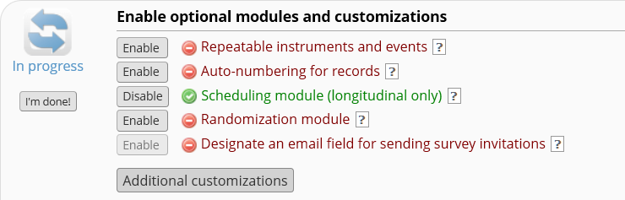
REDCap Optional Modules and Customizations
Other additional customizations:
Set a custom record label
Define a secondary unique field
Order the records by another field
Enable the Field Comment Log or Data Resolution Workflow (Data Queries)
PDF Customization
Set up Missing Data Codes
Enable the Data History widget for all data collection instruments
Enable the File Version History for 'File Upload' fields
Display the Today/Now button for all date and time fields on forms/surveys
Require a 'reason' when making changes to existing records
Notes:
On the project setup page, you will see a list of optional modules that you can use to customize your project. When you click the additional customization button, you will see more options available. Today, I will show you examples of some of these customizations.

Slide 4
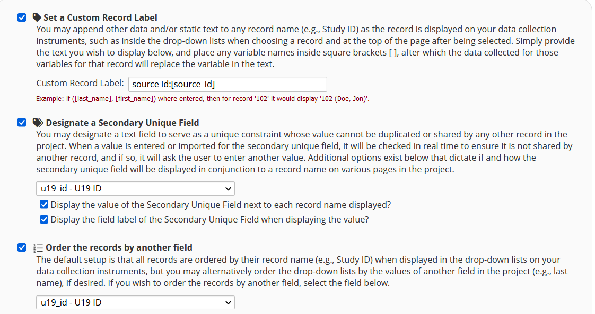
Optional Modules: Custom Record Label, Secondary Unique Field & Custom Record Order
Notes:
This is an example using custom record label and secondary unique field. This project tracks samples obtained from other institutions. Each institution has their own sample IDs. The sample ID is saved in the source ID field in this project. This project uses auto-numbering but also assigns a study ID, which is the U19 ID. So to make sure that no duplicate records can be saved in the database, the U19 ID is set as secondary unique field. The sort order is also set to use U19 ID to help users to identify records easily.

Slide 5
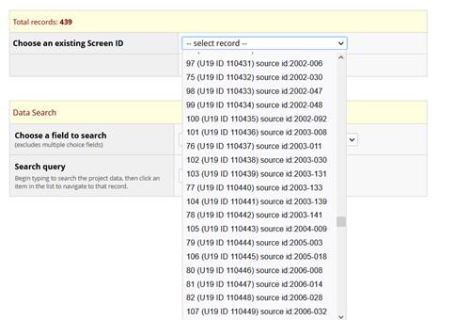
Optional Modules: Custom Record Label, Secondary Unique Field & Custom Record Order
Notes:
You will see in the select record drop down box the auto-assigned ID, U19 ID in brackets and the source ID. The dropdown list is sorted by U19 ID.

Slide 6
QUESTIONS?

Slide 7
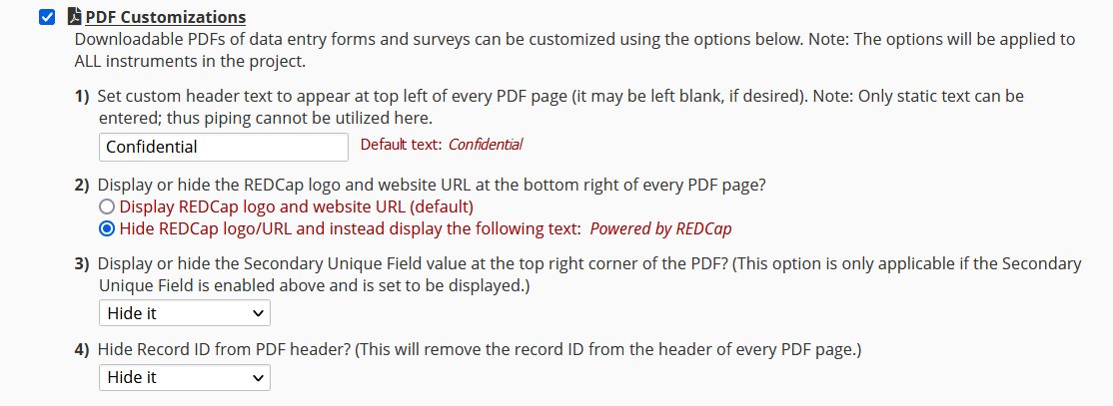
Optional Modules: PDF Customization
Notes:
There are a number of options that you can use to customize PDF of your data entry form or survey. For example, you can set custom header, hide REDCap logo/URL, hide secondary unique field and/or record ID. These customizations are helpful for eConsent. For eConsent, you should hide the record ID and secondary unique field in the PDF version of the consent form.

Slide 8
QUESTIONS?

Slide 9
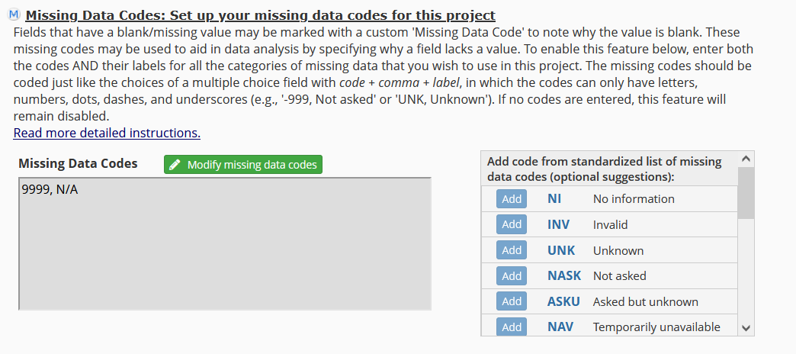
Optional Modules: Missing Data Code
Notes:
In REDCap, you can specify certain missing data codes to be used in the entire project. In this example, 9999 is used for not applicable (N/A). Whenever 9999 is entered in a text field, REDCap will show that this is the code for N/A. This code can be entered in text field with any validation.

Slide 10
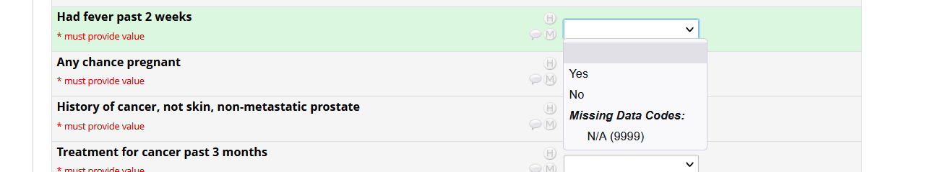
Optional Modules: Missing Data Code
Examples:
Notes:
Here are some examples. For the neck measurement field, the validation range is set at 22-60 cm.

Slide 11
QUESTIONS?

Slide 12
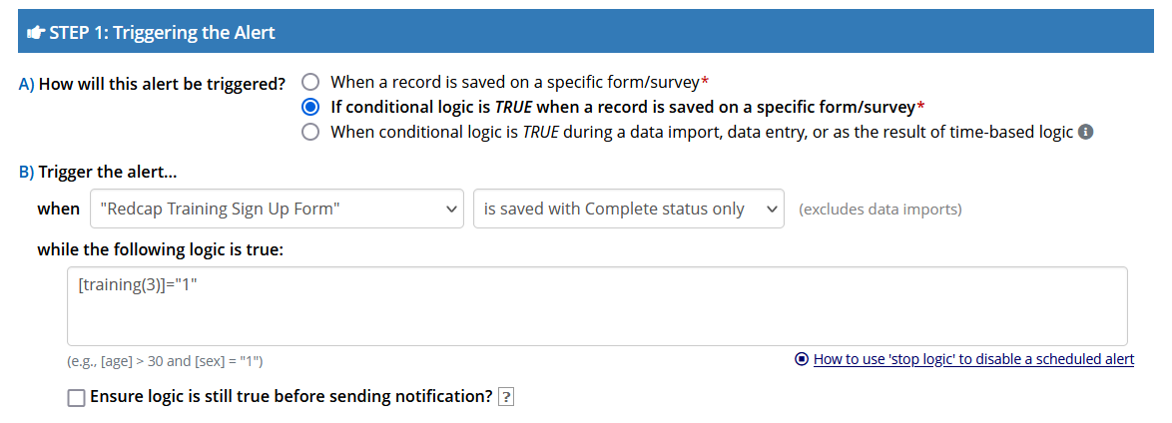
Alerts and Notifications
Construct alerts and send customized notifications
Can be sent to project users or recipients who are not REDCap users
Can use conditional logic to trigger notifications
Example – REDCap 201 Training confirmation email:
Notes:
Alerts and notifications can be used to send notifications, reminders, survey links to study participants. It can also be used to send notifications to study staff if a certain condition is met (e.g. an AE form is completed).

Slide 13
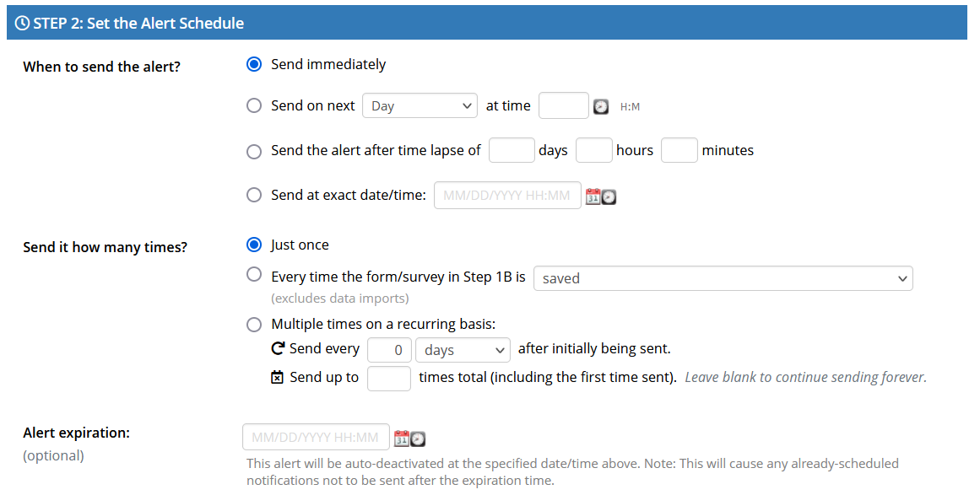
Alerts and Notifications
Notes:
This will

Slide 14
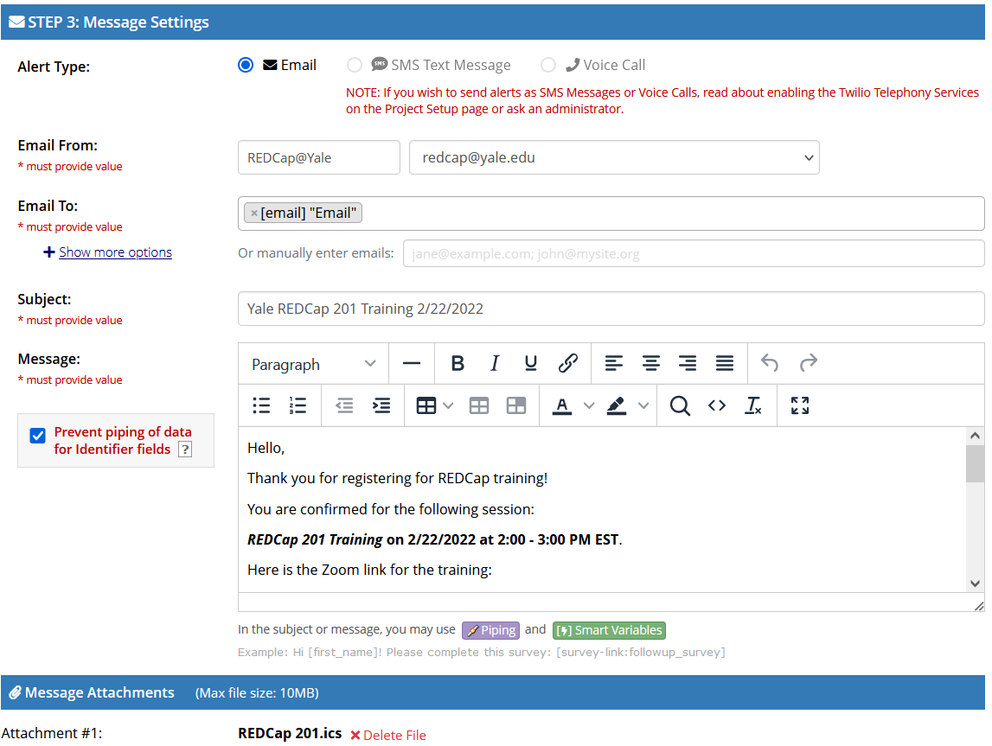
Alerts and Notifications
Notes:
This will

Slide 15
Alerts and Notifications
Other examples of alerts and notifications:
Enrollment notification
Randomization notification
Adverse Event notification
Send survey queue link to study participants
Notes:
This will

Slide 16
QUESTIONS?

Slide 17
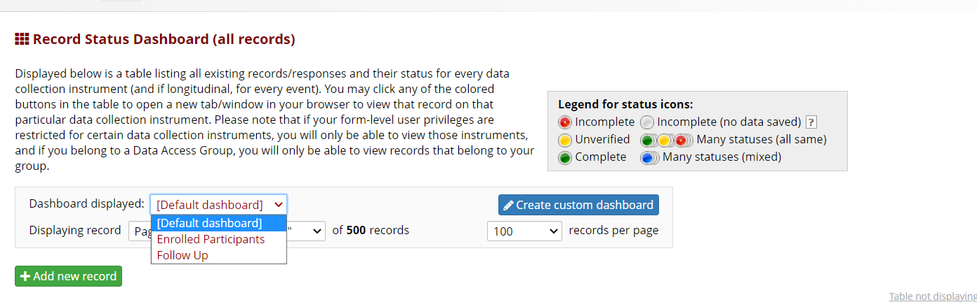
Custom Record Dashboard
Notes:
For large studies, it is very helpful to have custom record dashboards. The default dashboards will show all records, all events and forms. This usually means very wide and long dashboard. To make it easier to navigate, you can create custom dashboards to only show a subset of records, e.g., the enrolled participants or to only show the active participants with only the follow up events.

Slide 18
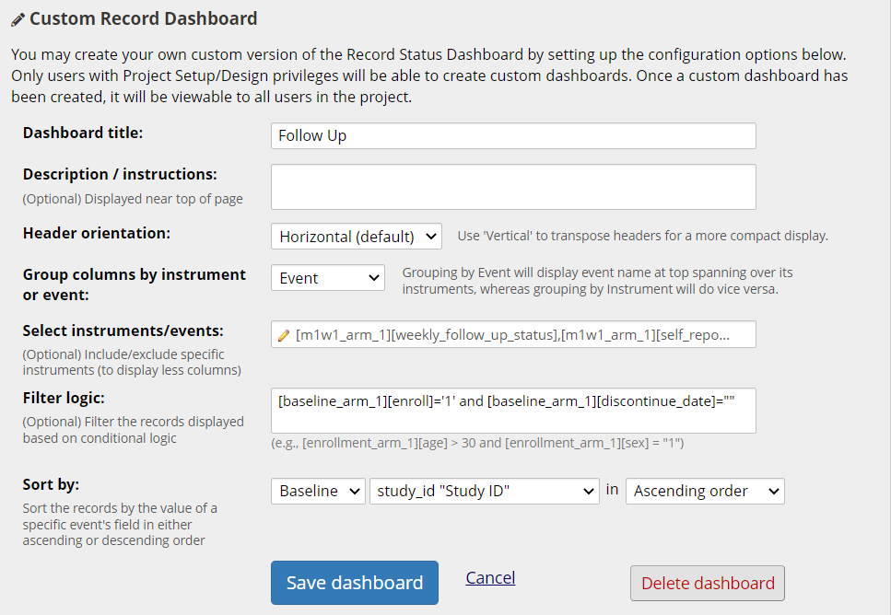
Custom Record Dashboard
Group columns by instrument or events
Select forms to display on the dashboard
Add record filter logic
Notes:
Here is an example of custom dashboard for follow-up. You can add filter logic to only show the active participants (in this case, enrolled=Yes and discontinuation date=empty). You can also select only certain forms or events to be shown on the dashboard. If you add a new form after setting up the custom dashboard, remember to update the instrument selection in the dashboard setting.

Slide 19
QUESTIONS?

Slide 20
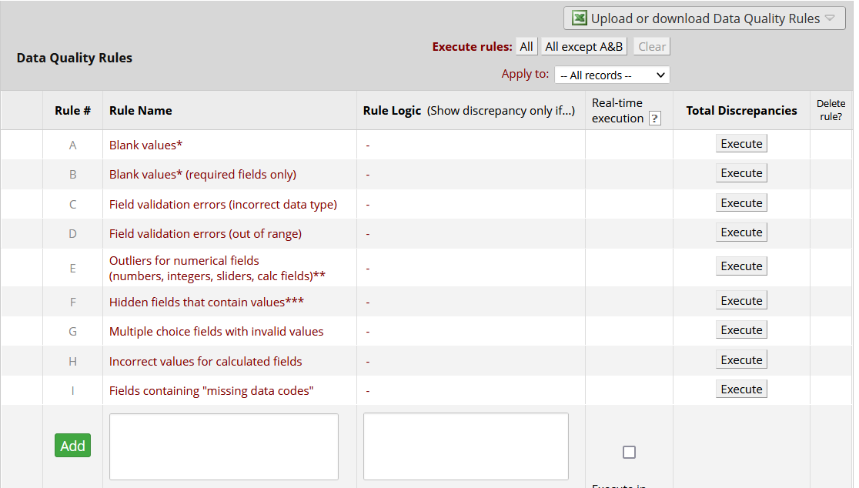
Data Quality Module
Notes:
Data quality module can be used to monitor data quality. There are 9 pre-set rules in the module. You can also set up your own custom rules. One of the most helpful rules is rule H. If you change any calculated fields after data are collected, you can use rule H to fix the data already collected in the database.

Slide 21
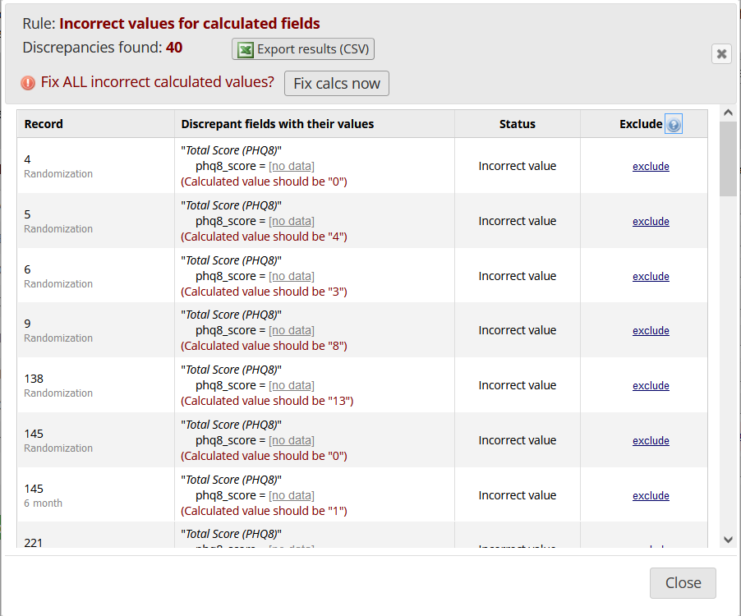
Data Quality Module – Rule H Example
Notes:
In this study, the PHQ 9 form was changed to PHQ 8 after study data have been collected and a new field PHQ 8 score was added to the form. The existing records do not have data for this field. Rule H was used to populate the data for this field.

Slide 22
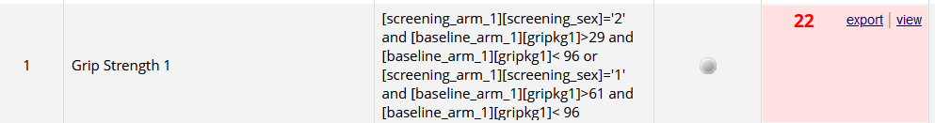
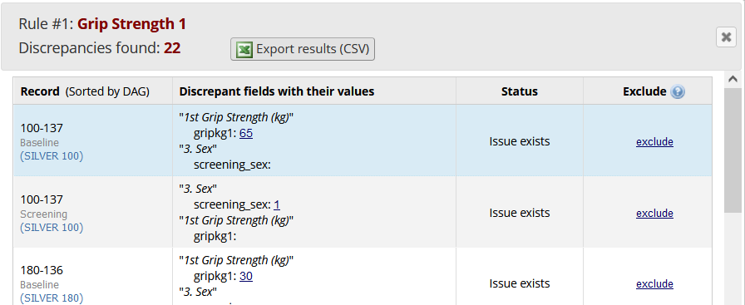
Data Quality Module – Custom Rule Example
Notes:
Data quality module can be used to monitor data quality.

Slide 23
QUESTIONS?

Slide 24
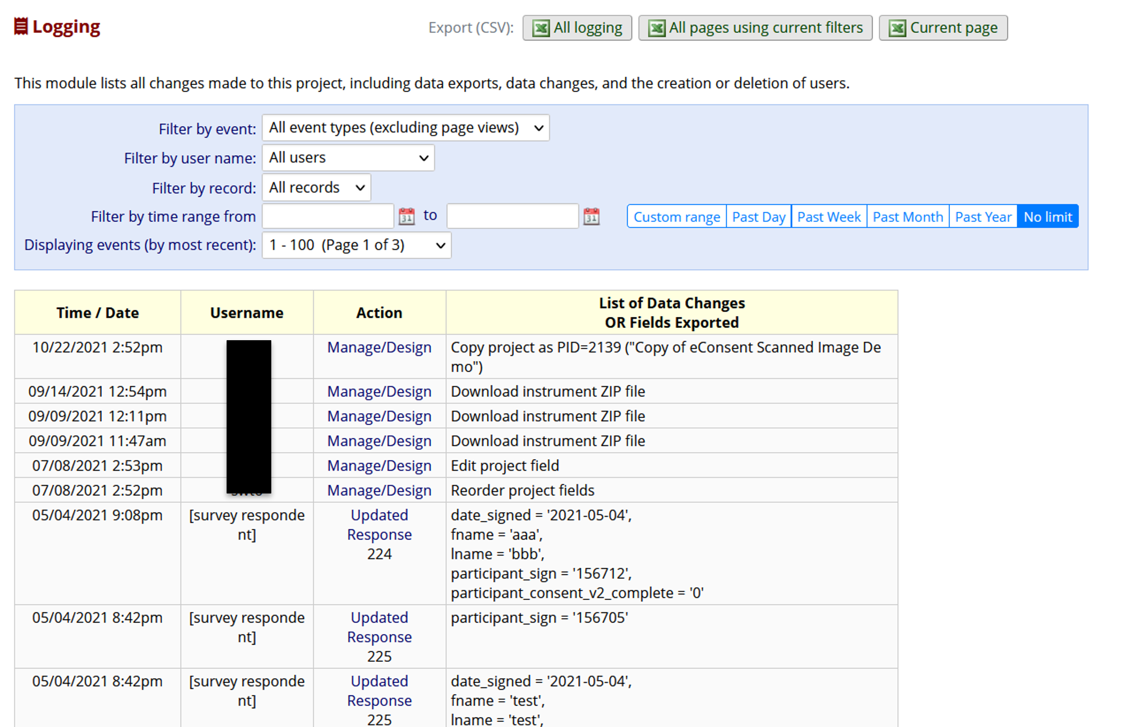
Logging
Notes:
Logging is the audit trail of your project. It records all changes made to the project. It is important for research studies and is a great tool for troubleshooting data problems. For example, if a participant submitted a survey but you do not see the survey data in your project. The best way to troubleshoot is to examine the logging to confirm that the survey was actually submitted and whether the data were overwritten after submission. One possible scenario is that the staff had the survey opened in form mode while the participant submitted the survey. When the staff closed the form and clicked save, the empty form overwrote the data from the survey.

Slide 25
QUESTIONS?

Slide 26

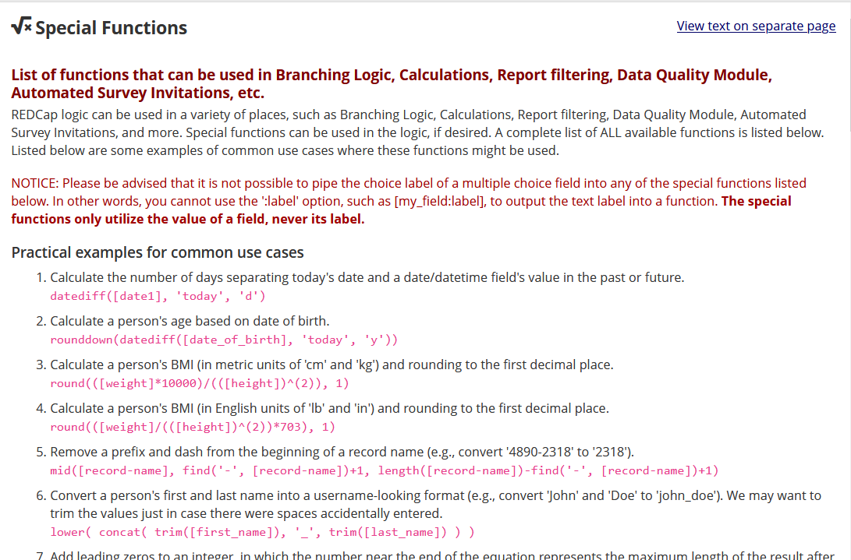
Special Functions for Calculation, Branching Logic

Slide 27
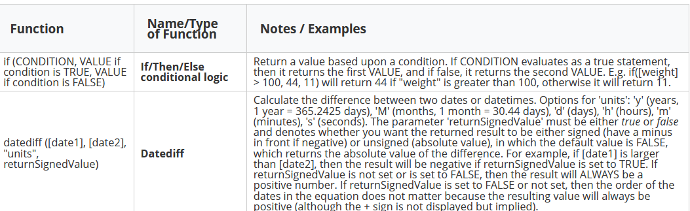
Special Functions for Calculation, Branching Logic
Most popular functions:

Slide 28
Examples – If/Then/Else
Eligibility calculation
  Initial Eligibility (1=Eligible, 0=Ineligible)
    if([inclu1]='1' and [inclu2]='1' and [inclu3]='1' and [inclu4]='1' and [exclu1]='0' and ([exclu2]='0' or [exclu2]='2') and [exclu3]='0' and [exclu4]='0' and [exclu5]='0' and [exclu6]='0' and [exclu7]='0', 1, 0)
Change text of field label based on event
  @CALCTEXT(if([event-name]='baseline_arm_1','your life','the last month’))

Slide 29
Examples – DateDiff
Age at Enrollment
  rounddown((datediff([dob],[enroll_date], 'y'),0)
Number of weeks from MAT start date
  round(((datediff([scrn_mat_start], [call_date], 'd'))/7),1)
Branching logic to show warning
  datediff([medical_abstractio_arm_1][hosp_discharge], [admitdate1], "d", true)<1 or datediff([medical_abstractio_arm_1][hosp_discharge], [admitdate1], "d", true)>180
Notes:
MAT stands for medication assisted treatment

Slide 30
QUESTIONS?

Slide 31
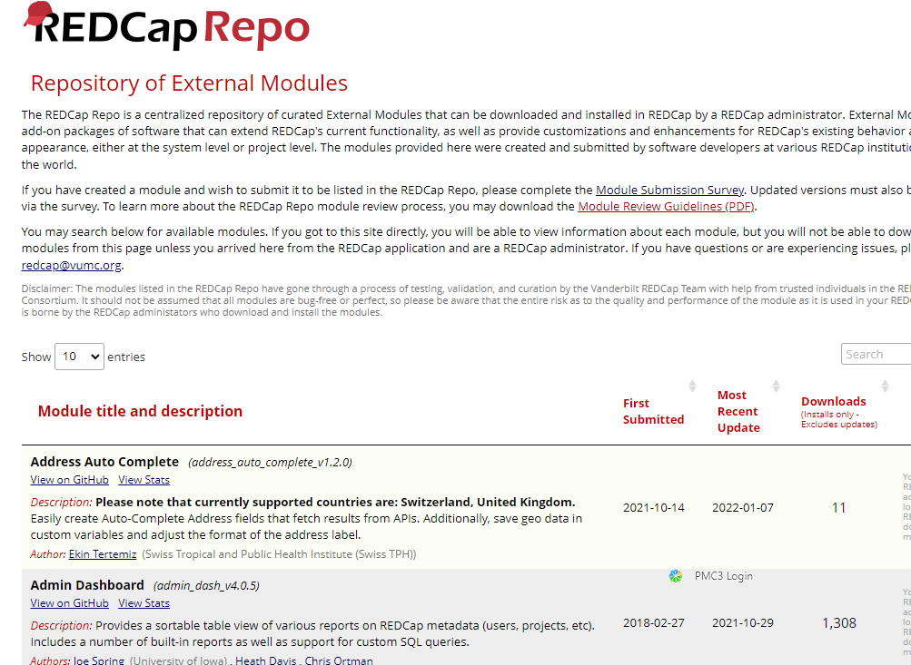
External Modules (EMs)
Individual packages of software that extend REDCap's functionality.
External Modules provide customizations and enhancements for REDCap's existing behavior and appearance at the system- or project- level.

Slide 32
External Modules (EMs)
Commonly used external modules
  Form Render Skip Logic
    Show and hide forms based on branching logics
  Image Map
    User can click on image regions to select field options, e.g. pain map
  Cross-project piping
    Pipe data from one project to another project
  Auto Complete Form Status Based on Required Fields
  MyCap
*Contact REDCap@Yale for suitability of external modules for your project

Slide 33
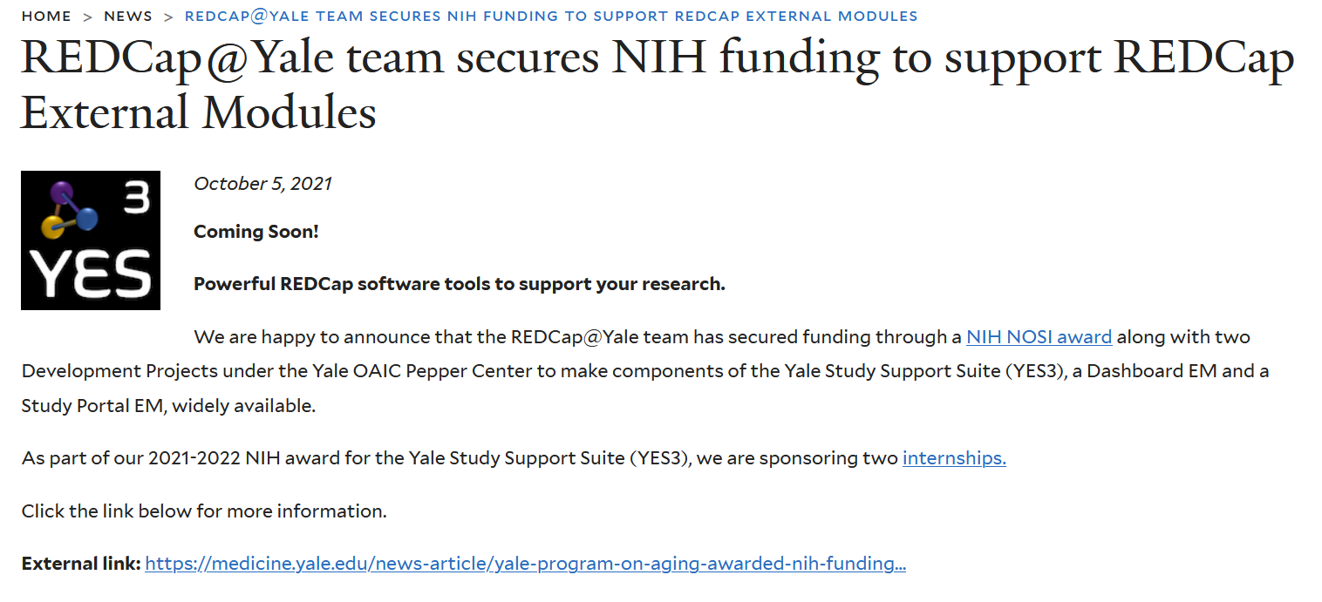
YES³ External Module:
Coming Soon in 2023

Slide 34
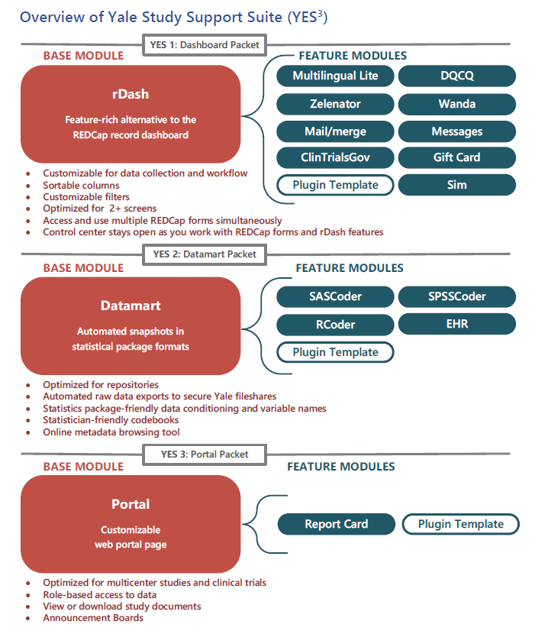

YES3
With these funding awards, we are building 2 of 3 Base Modules that comprise the Yale Study Support Suite (YES3).
Once completed, Dashboard and Web Portal EMs will be available to REDCap@Yale users for free with training on how to use them.
These advanced software tools have been foundational to our team’s success in running research studies. We are excited to share these tools with you.

Slide 35
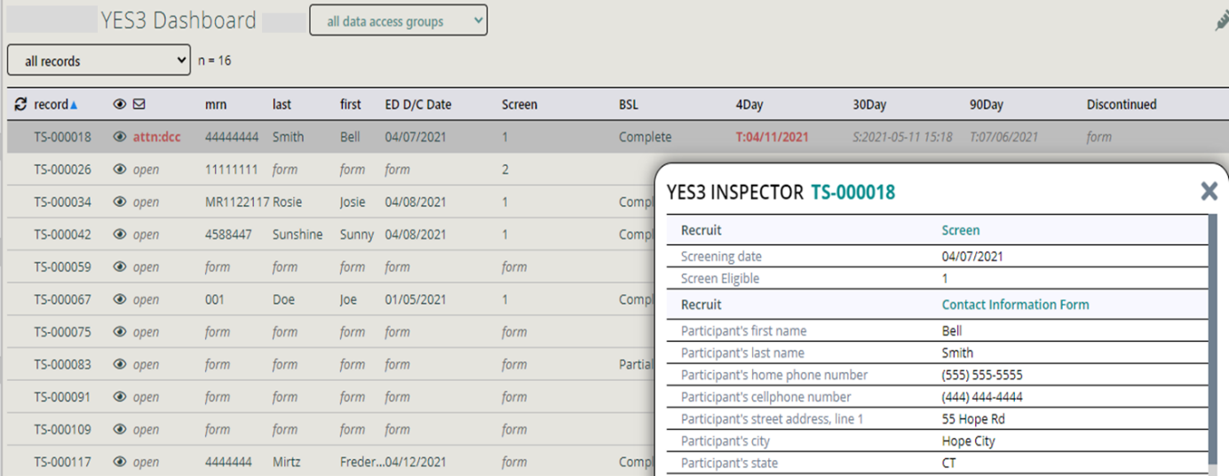
A sneak peek at the Dashboard EM

Slide 36
A sneak peek at the Web Portal

Slide 37
QUESTIONS?

Slide 38
Thank You!
Further Questions: Contact us at REDCap@yale.edu

